Slide 1
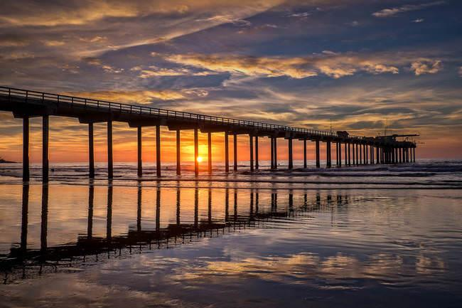
Chorusing Fish in the La Jolla Kelp Forest: 2015 - Present
Annette Brennan
Camille Pagniello Jack Butler Ana Širović

Slide 2

Fish Make Noise?
Notes:
1956 DIRECTED

Slide 3
Fish Make Noise?
NO
Notes:
1956 DIRECTED

Slide 4
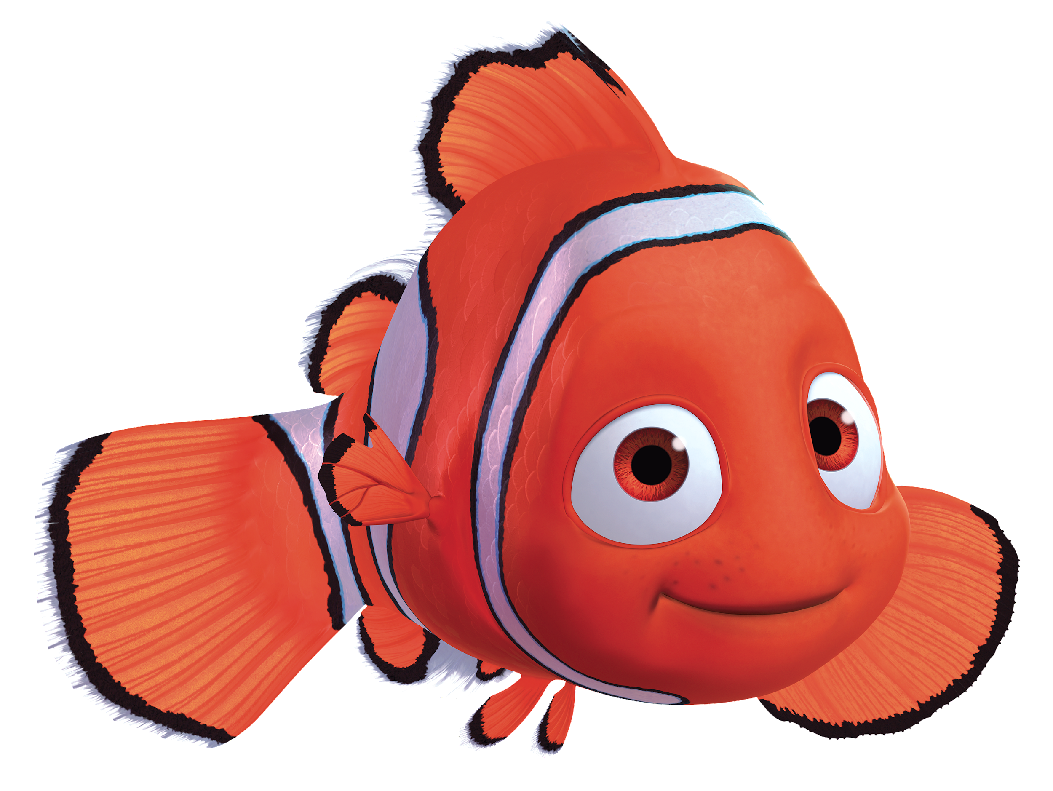
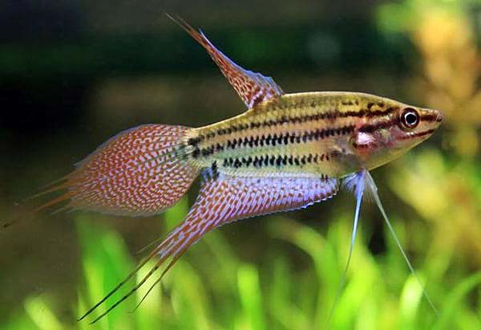
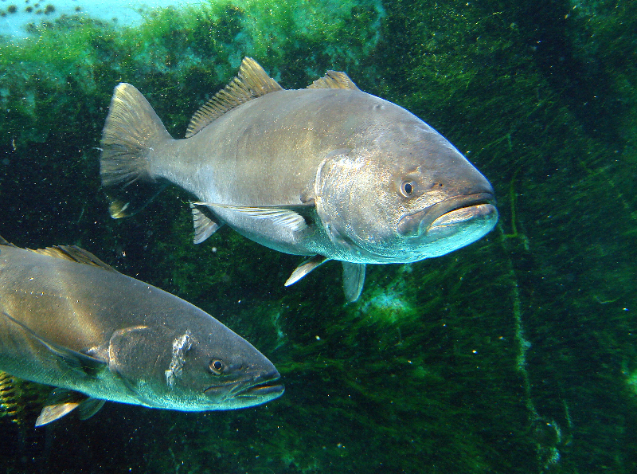
Fish Make Noise!!
Unspecialized sounds
Active Sounds
Stridulation
Stringing
Drumming
Radford et. all 2014

Slide 5
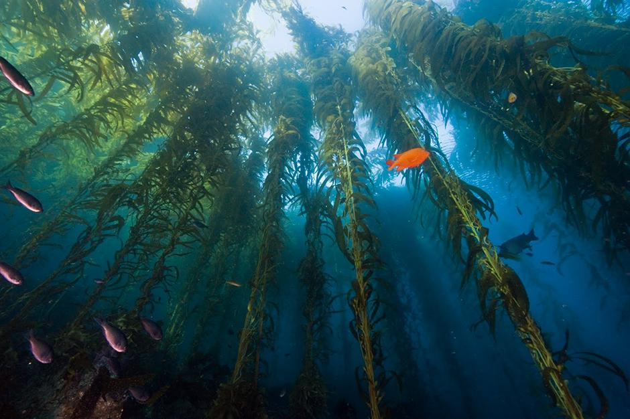
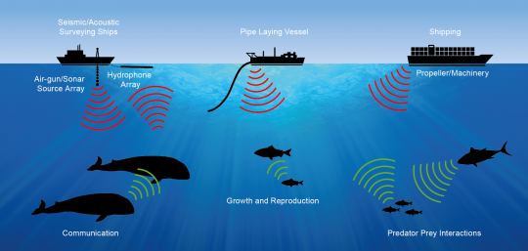
Using Passive Acoustics to Monitor Species and Ecosystem Health

Slide 6
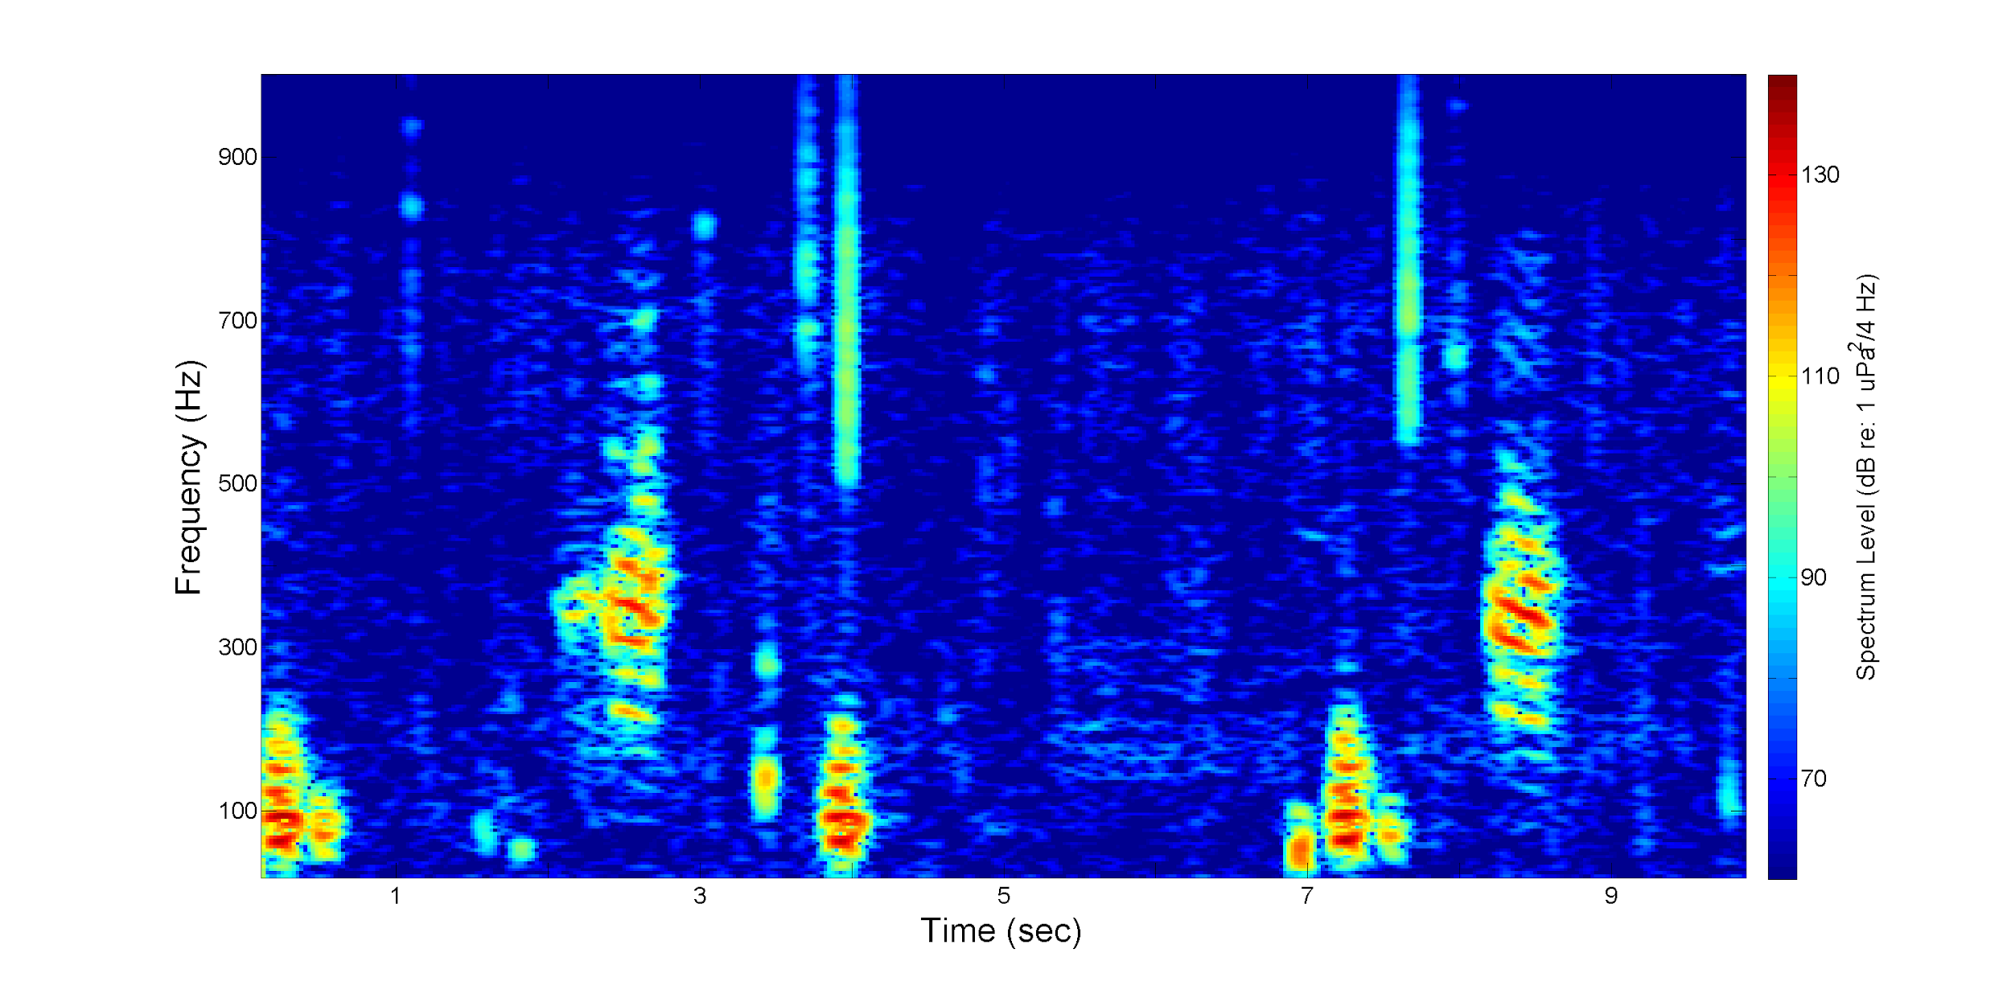
2 Different Fish Calls
Notes:
INTENSITY
ABUNDANCE
CHORUS VS CALL
EFFORT MASKING

Slide 7
2 Different Fish Calls
300-500 Hz Calls
100 Hz Calls
Notes:
INTENSITY
ABUNDANCE
CHORUS VS CALL
EFFORT MASKING

Slide 8
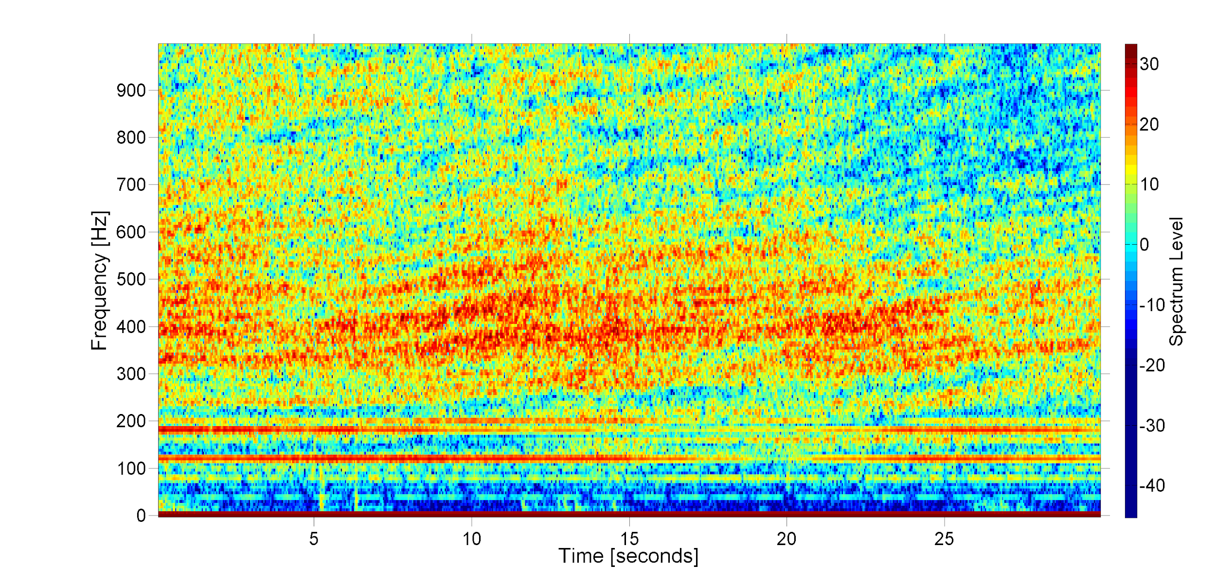
Masking and its Effects on Effort

Slide 9
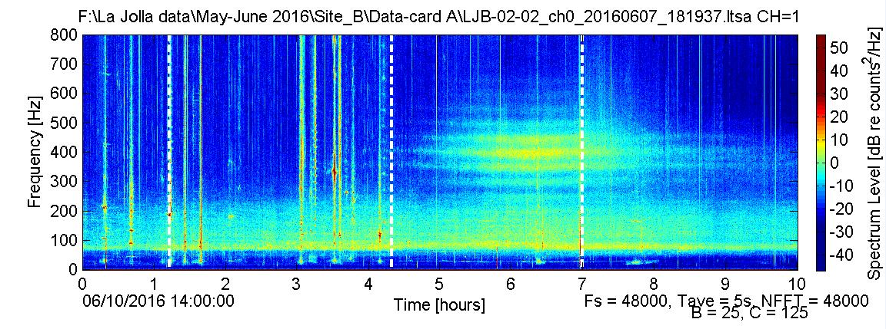
Chorusing
Chorus: When individual fish calls were so abundant they were no longer decipherable

Slide 11
Objective
Existing Data
What are the trends of these calls?
Diel
Spatial
Annual
Field Work
Where is the chorus being made?
Who is making the chorus?

Slide 12
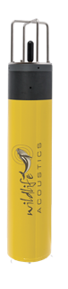
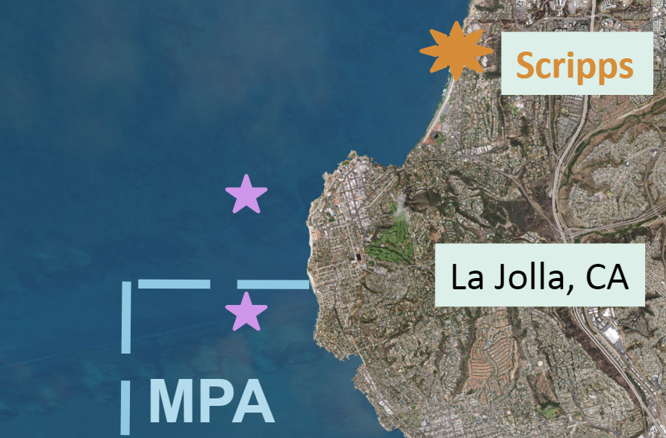
Logging Existing Data
May 2015: 5 Days Each - Site A & B
May 2016: 15 Days Site B
May 2017: 16 Days Site B
Site A
Site B
Notes:
10/60
POINTS vs PERIODS

Slide 13
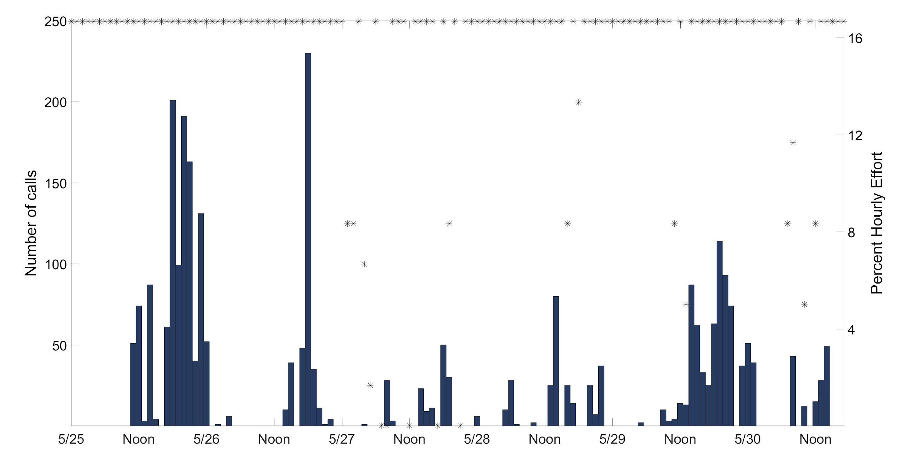
100 Hz Call, 2015, Site A

Slide 14
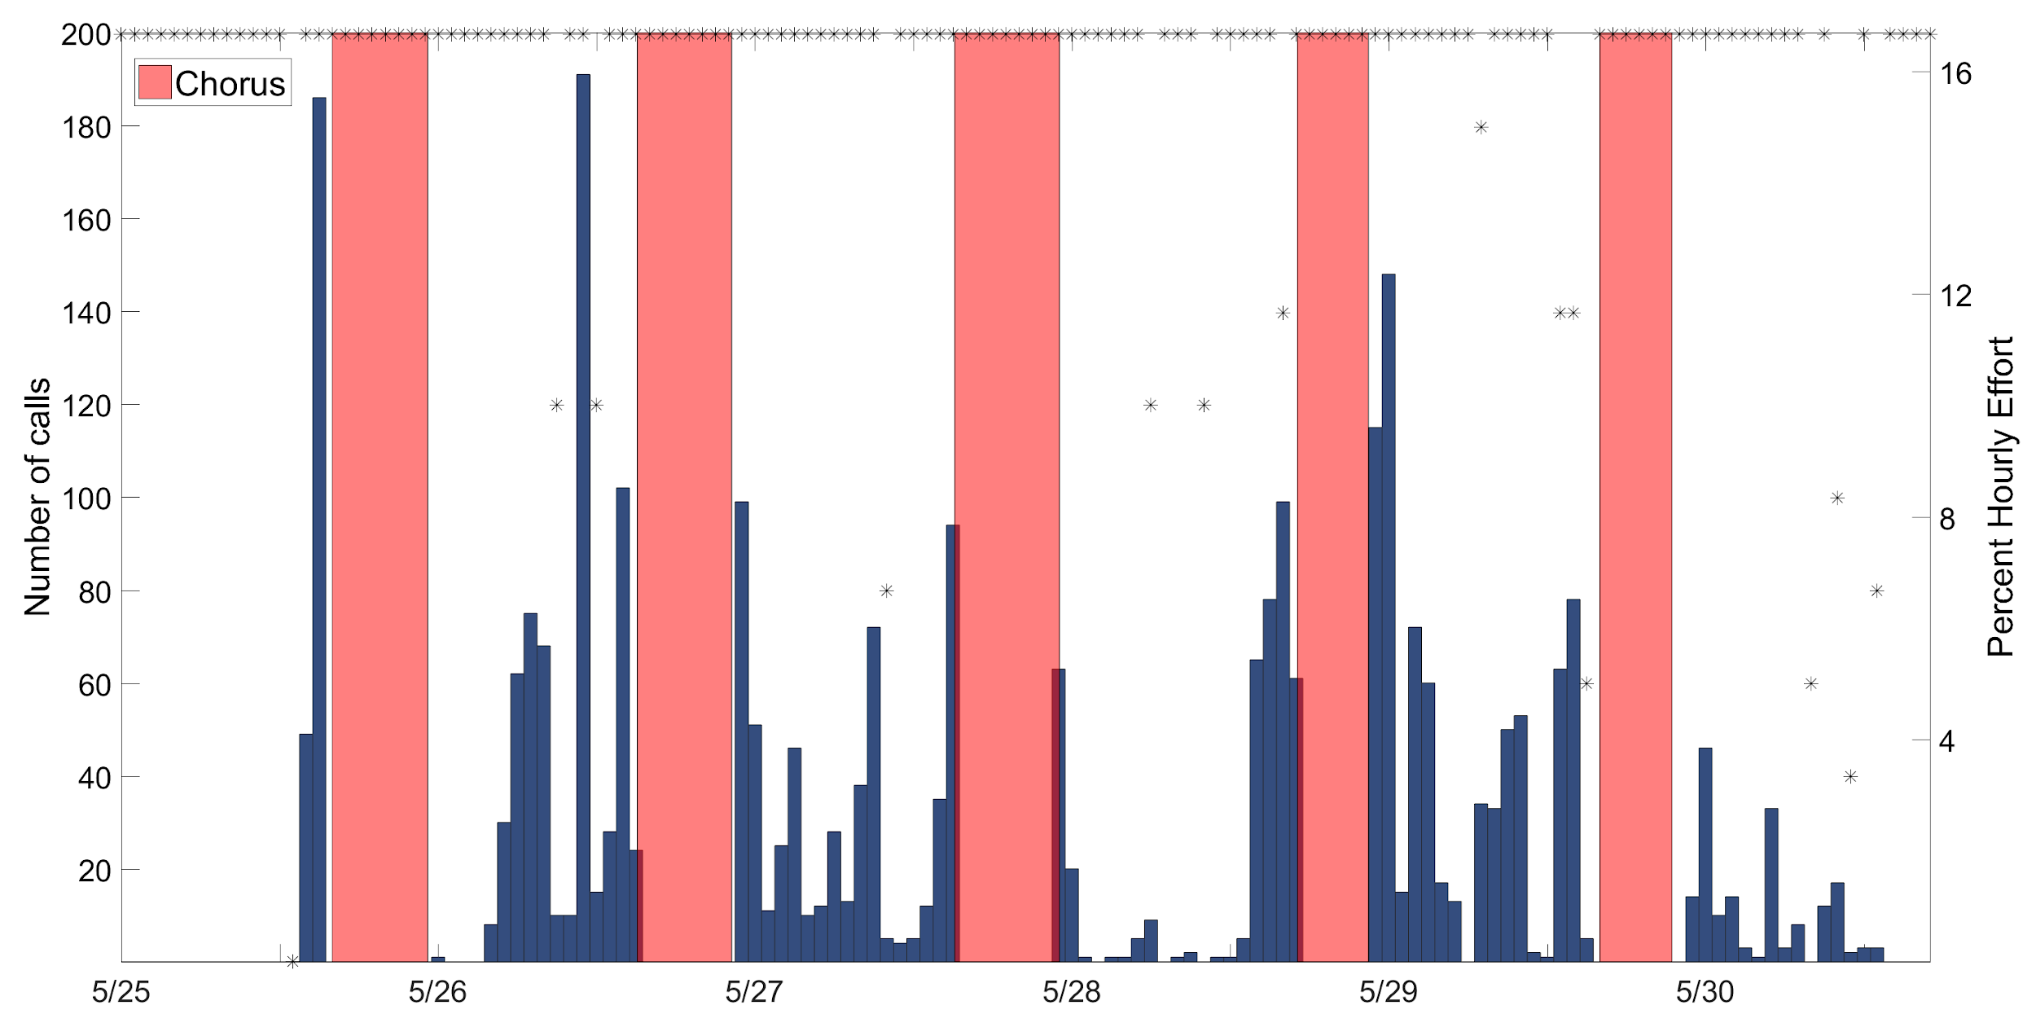
Diel Trend: 100 Hz Call
2015 Site B

Slide 15
Spatial Trend: 100 Hz Call 2015
2015 Site A
2015 Site B
Notes:
VARIABILITY

Slide 16
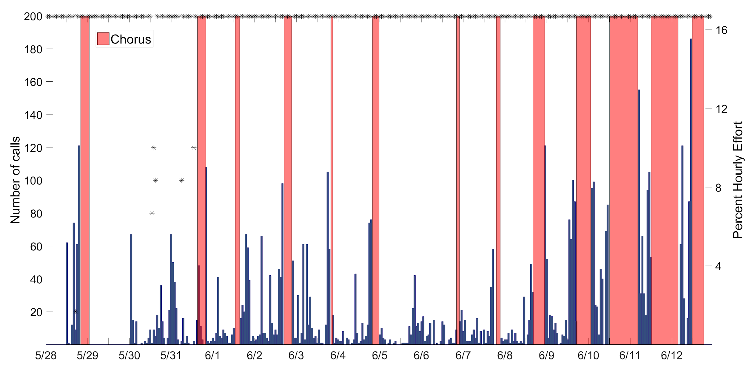
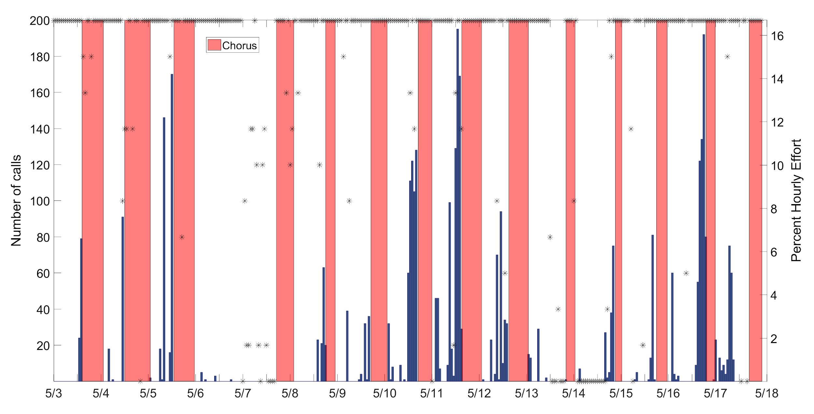
Annual Trend: 100 Hz Call Site B
2015
2016
2017
Notes:
VARIABILITY

Slide 17
Diel Trend: 300-500 Hz Call
2015 Site A

Slide 18
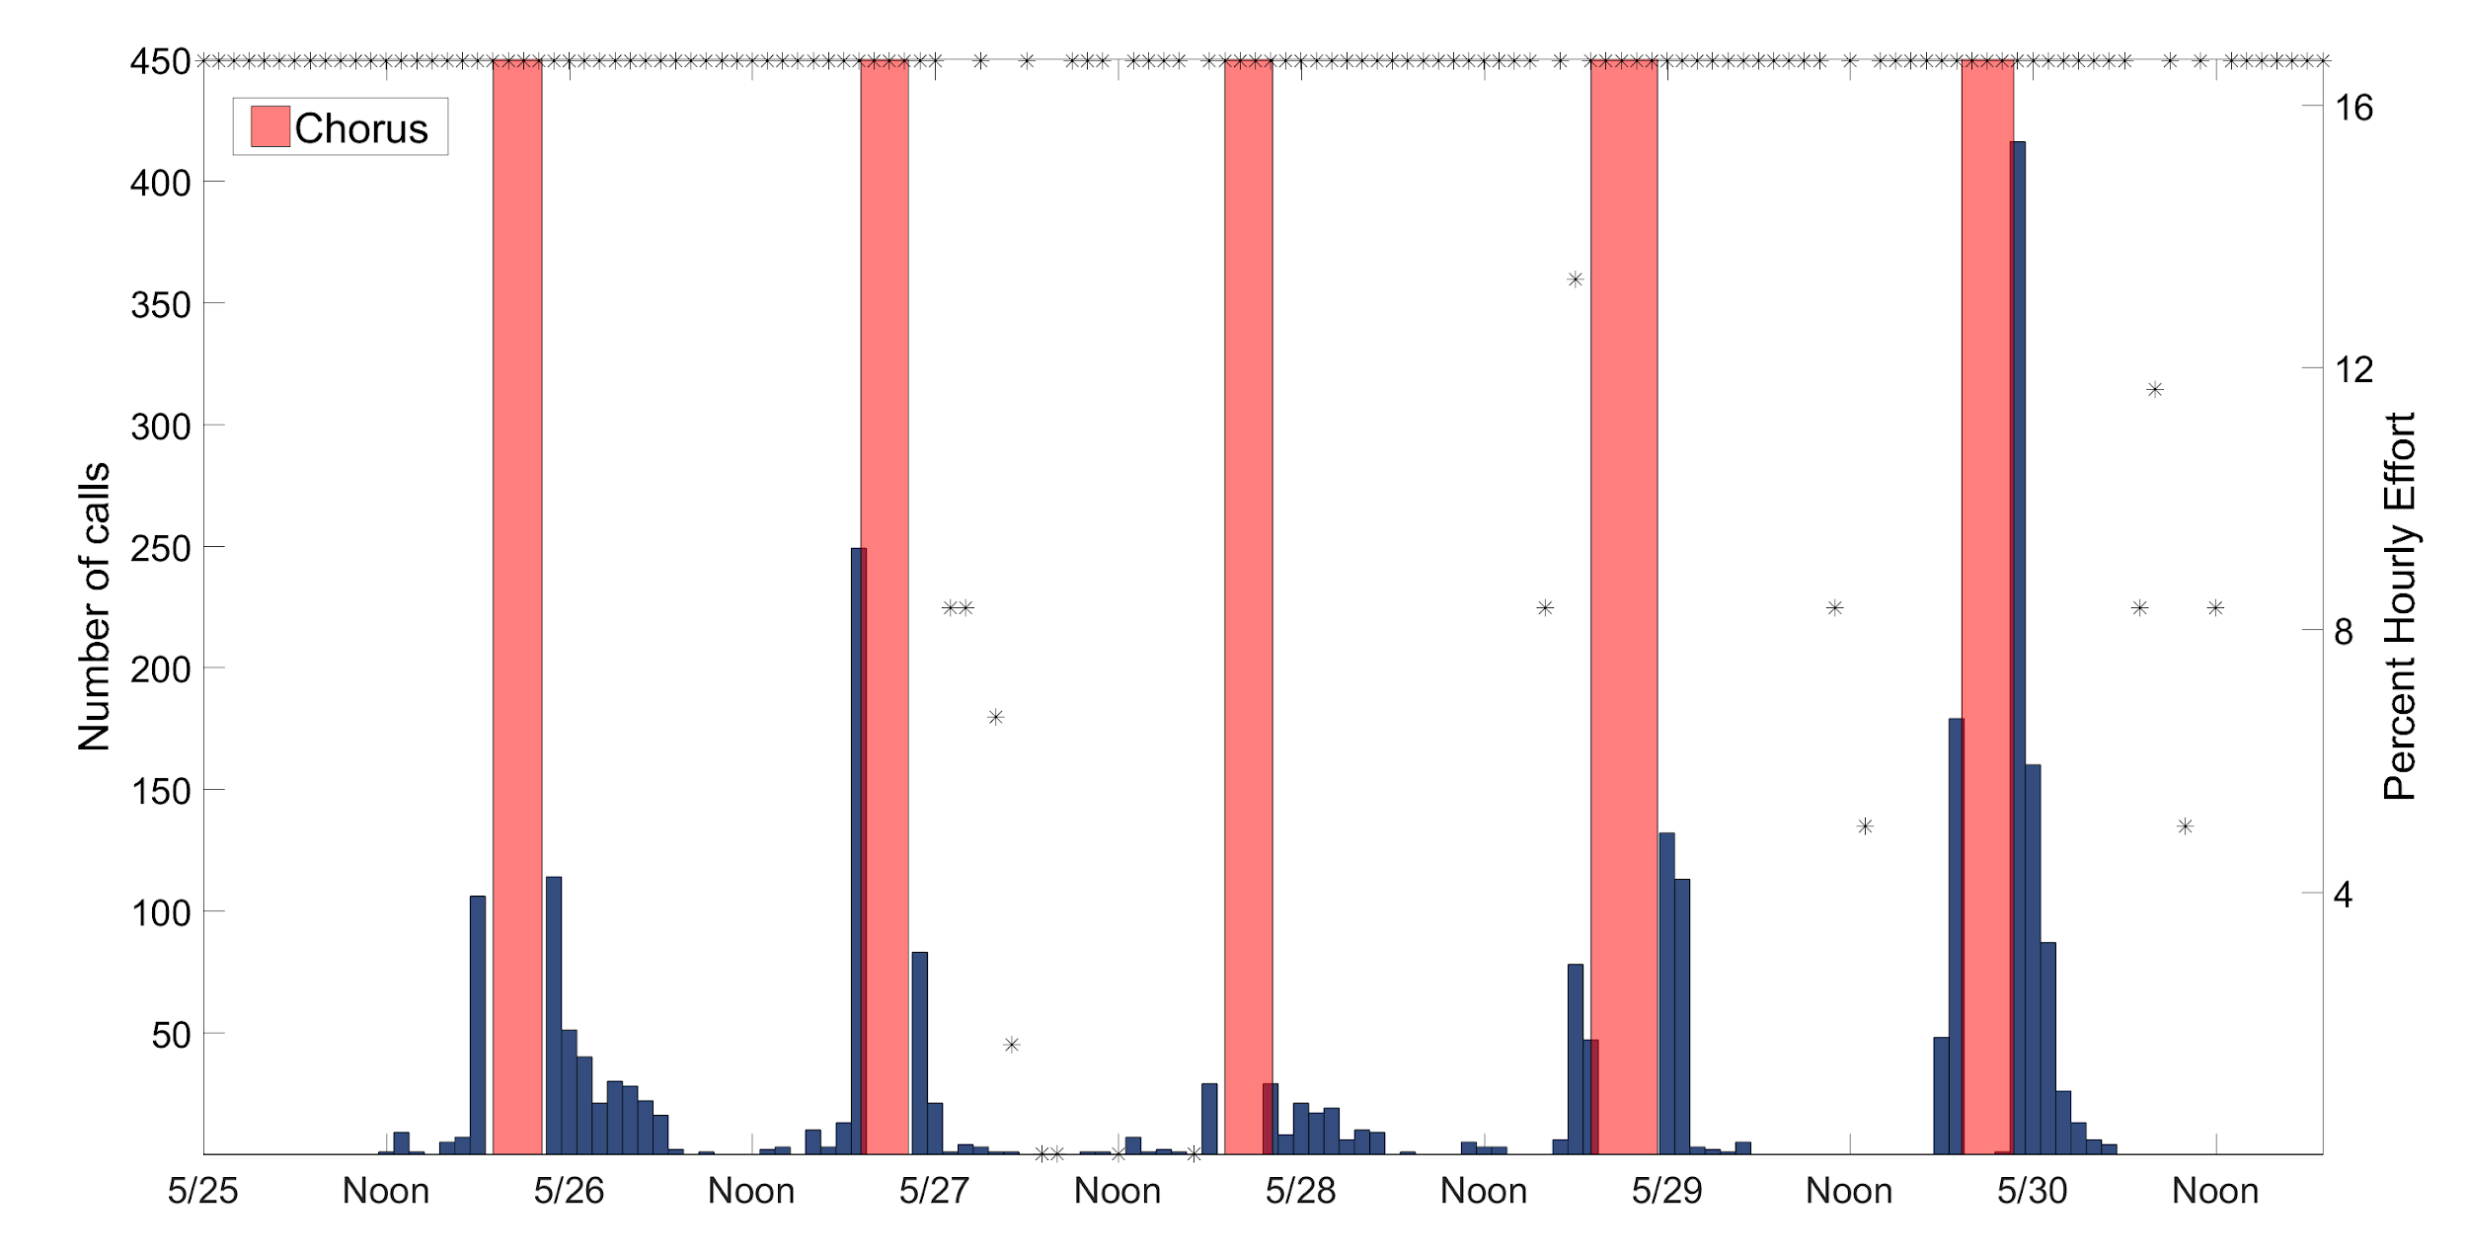
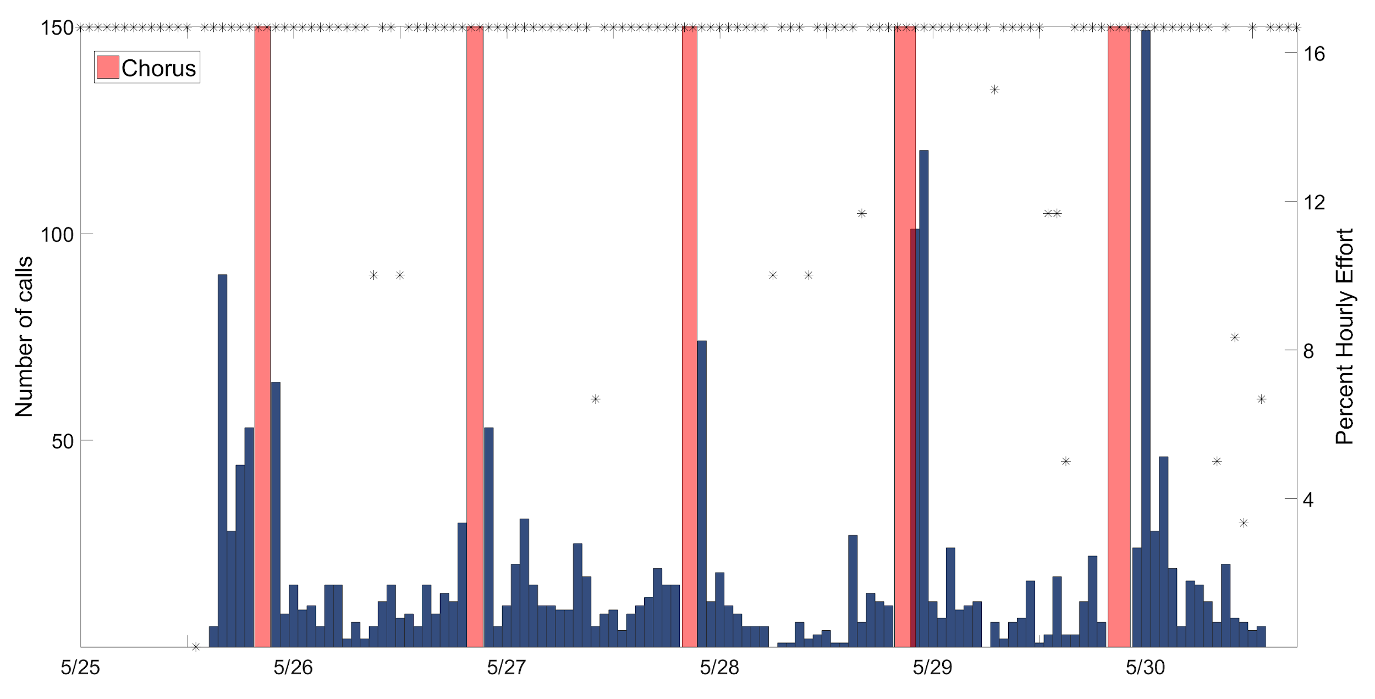
Spatial Trend: 300-500 Hz Call 2015
2015 Site A
2015 Site B
Notes:
VARIABILITY

Slide 19
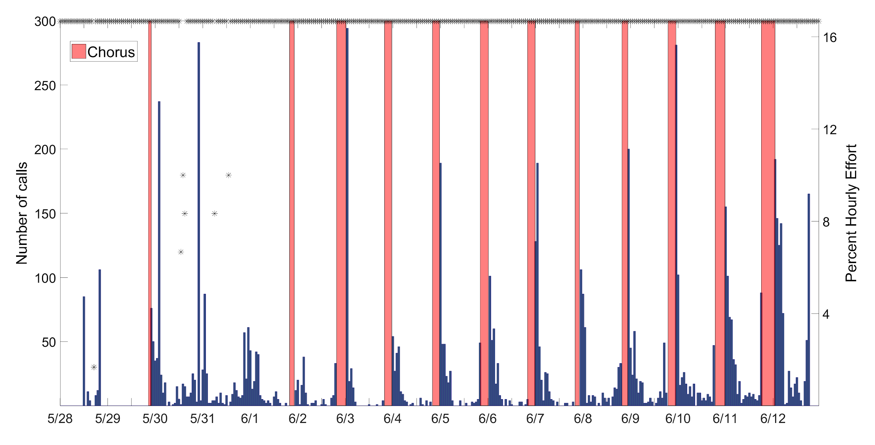
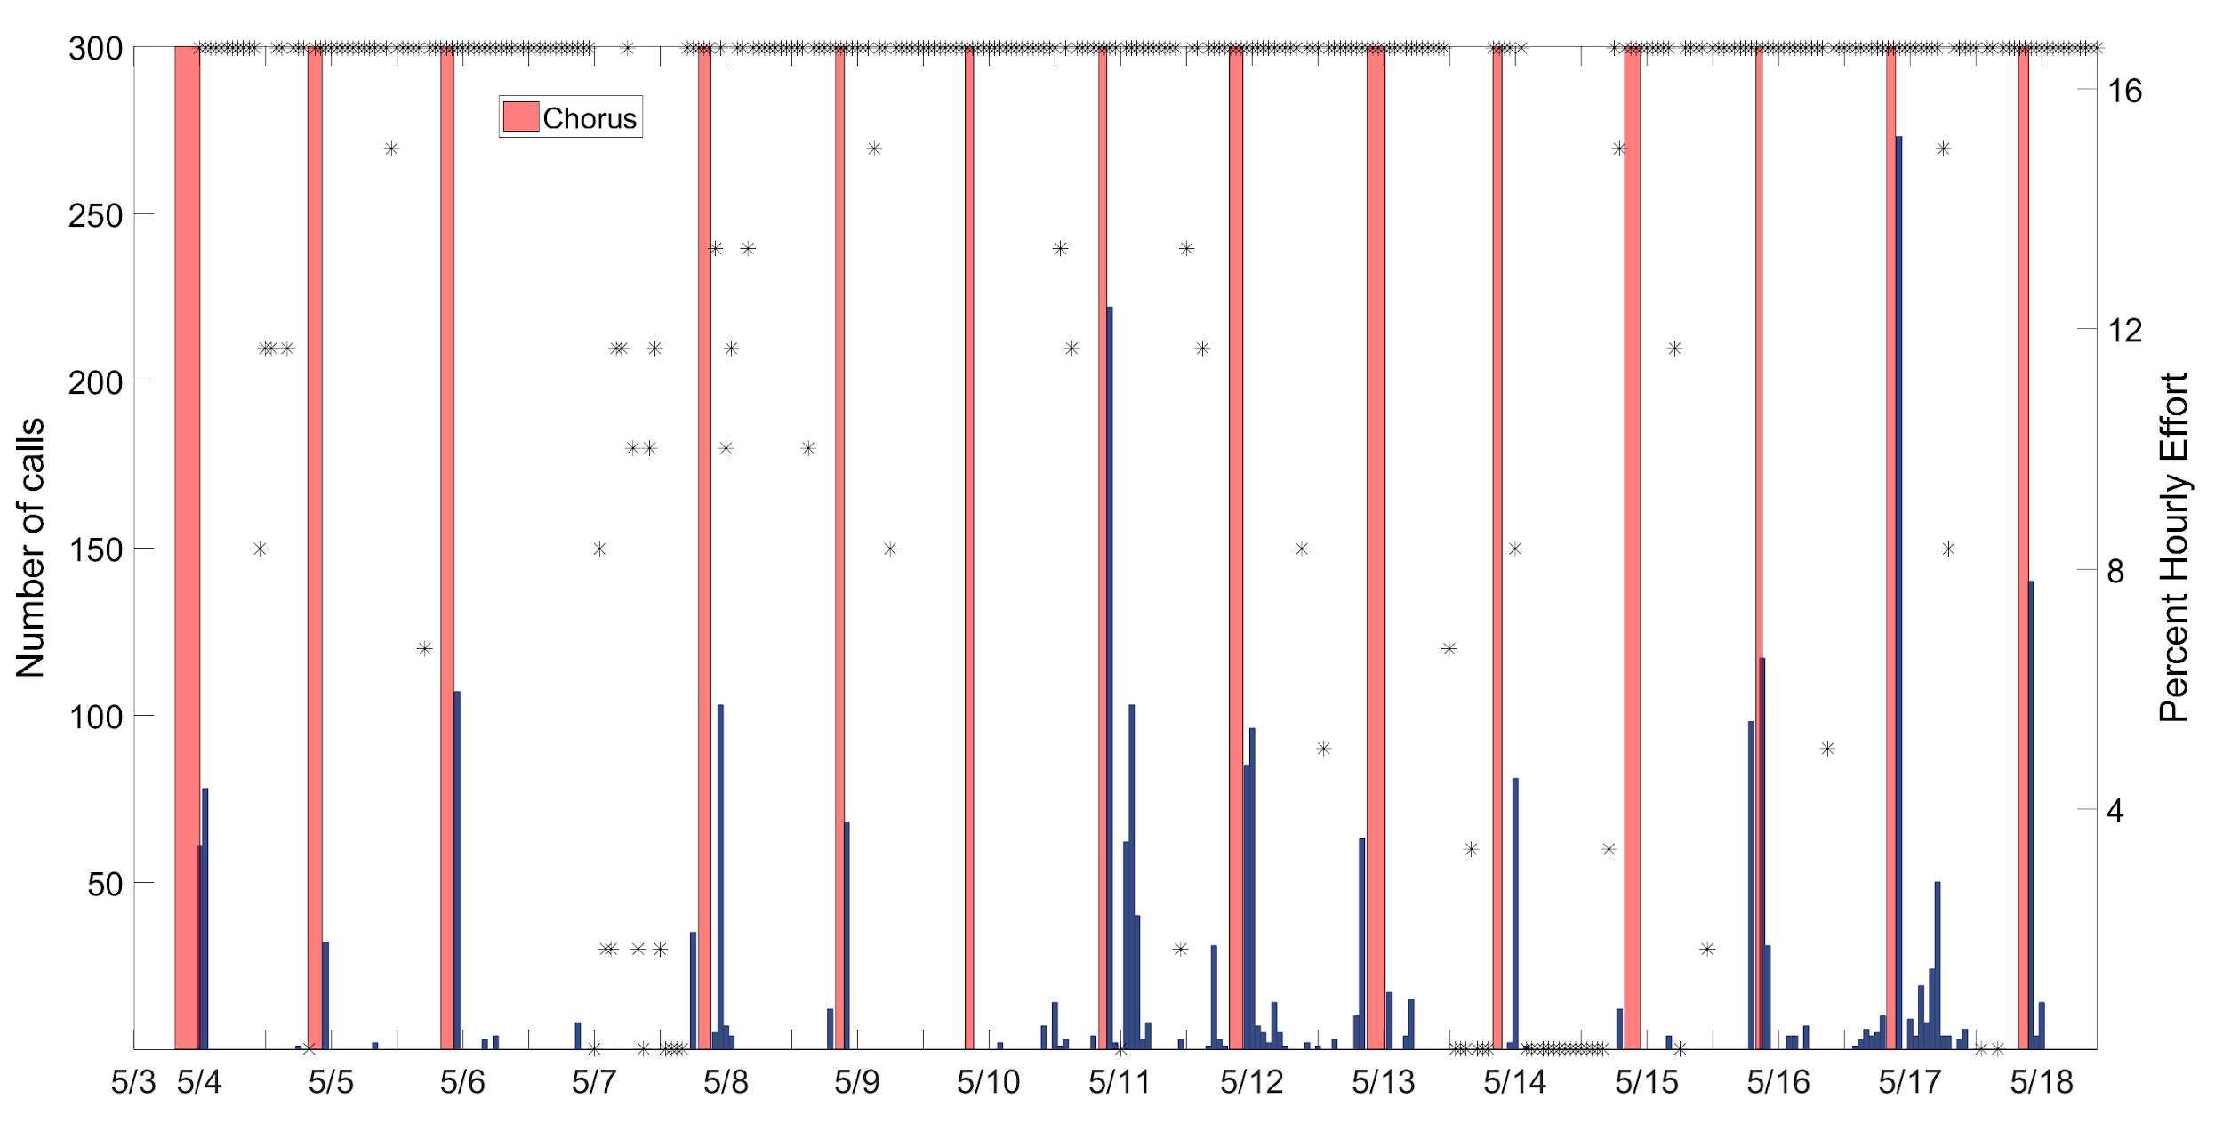
Annual Trend: 300-500 Hz Call Site B
2015 Site B
2016 Site B
2017 Site B

Slide 20
Conclusions...
100 Hz Call
Diel
Call abundance increases at night
Chorus 6-12 hr
Spatial
Site A had no chorusing
Annual
Consistently chorusing, though length of chorus varies
300-500 Hz Call
Diel
Call abundance increases at night
Chorus ~3 hr
Spatial
Similar diel periodicity throughout
Annual
Similar diel periodicity throughout

Slide 21
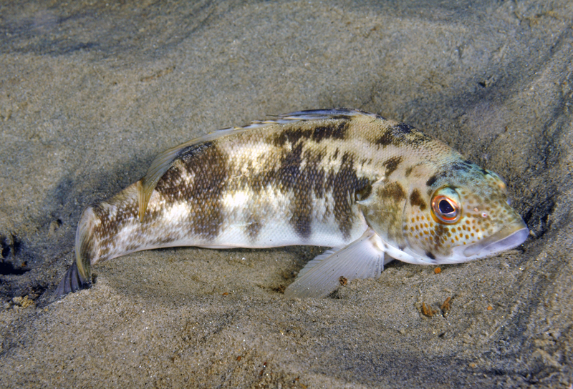
Observations Thus Far
White Seabass (Atractoscion nobilis)
100 Hz call
Barred Sand Bass (Paralabrax nebulifer)
300-500 Hz call
Notes:
Aalbers and Drawbridge
Ed Parnell Anecdotal Evidence

Slide 22
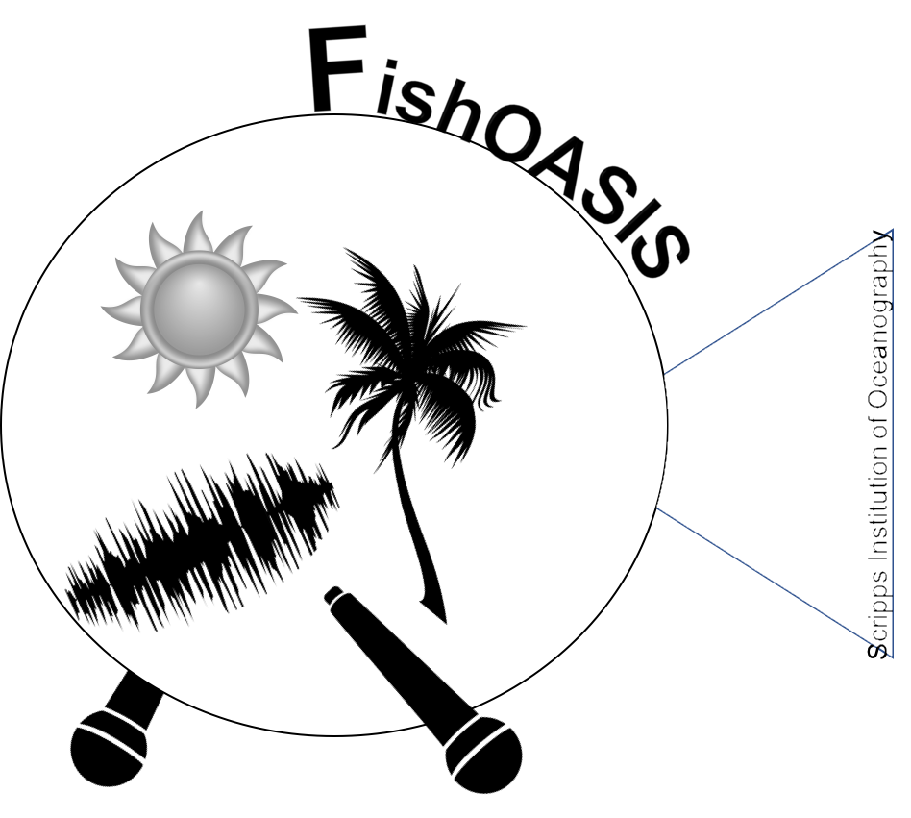
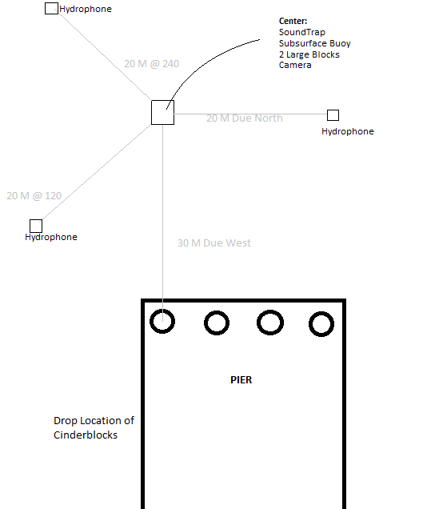
Add a Camera

Slide 23
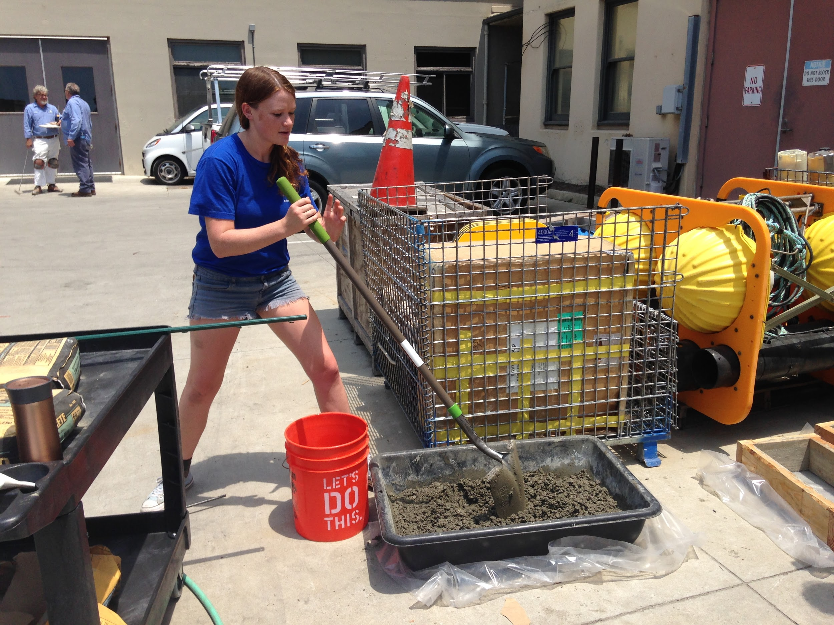
Add a Camera

Slide 24
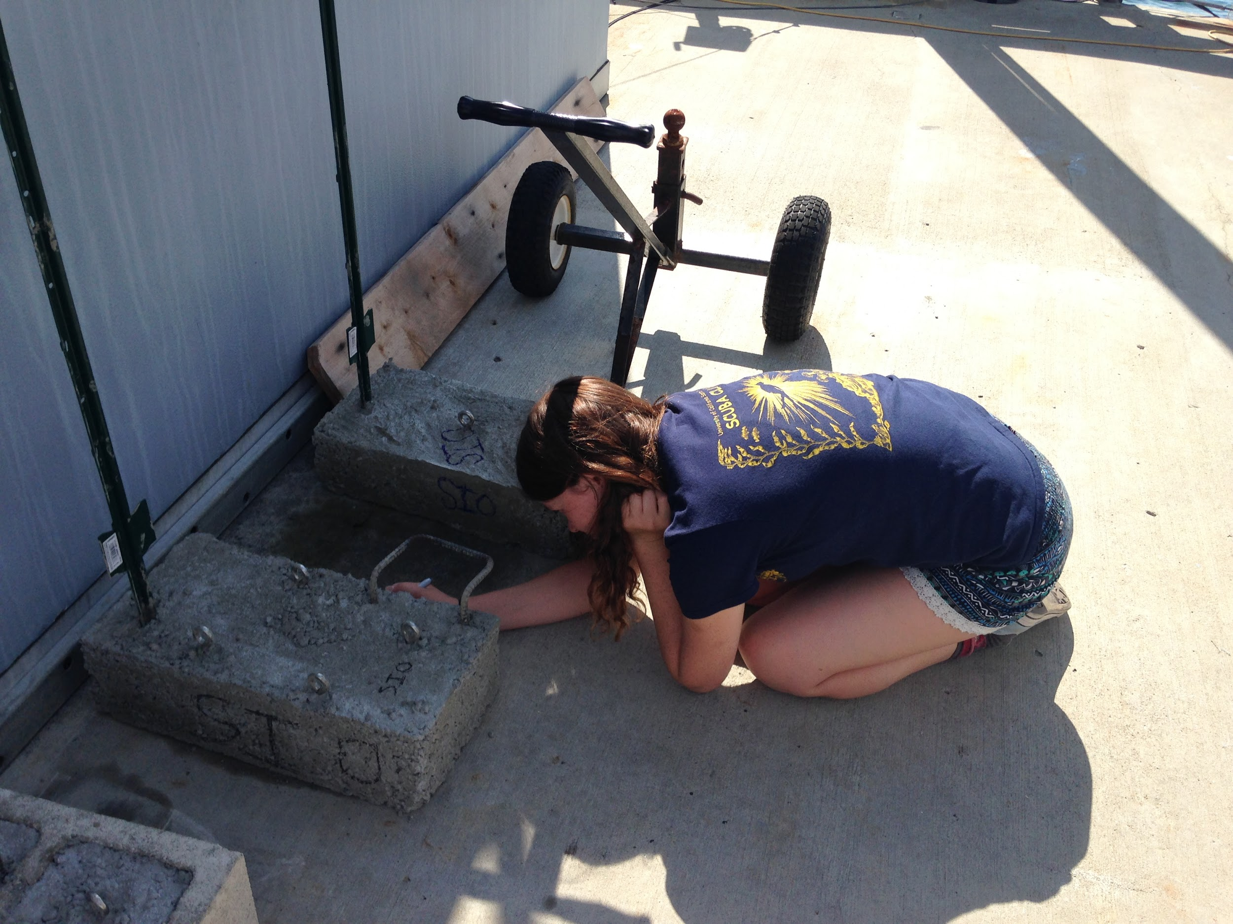
Add a Camera

Slide 25
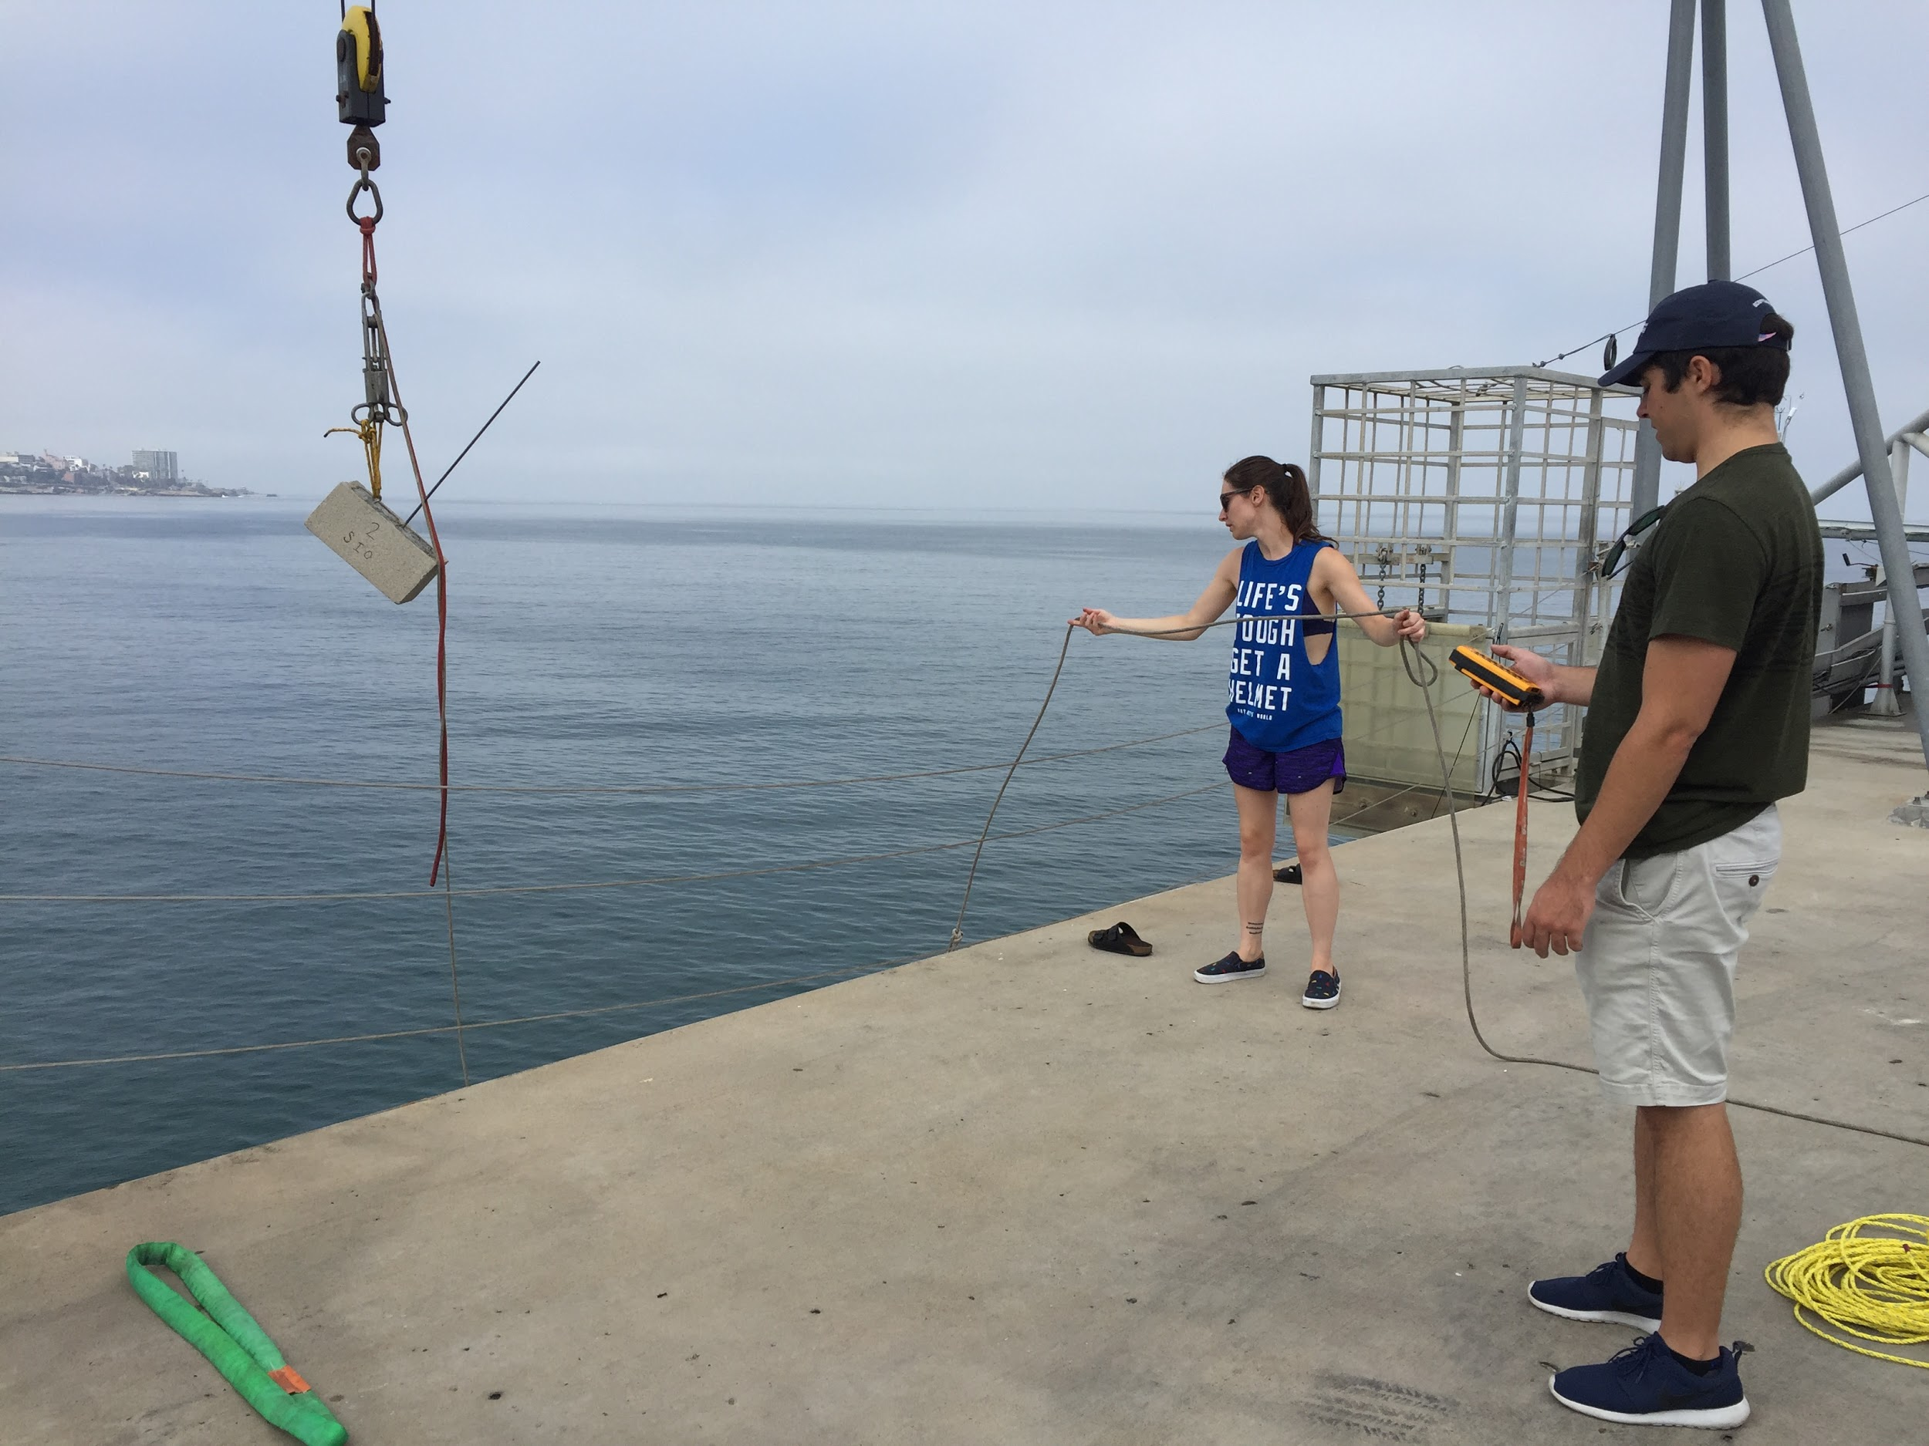
Add a Camera

Slide 26
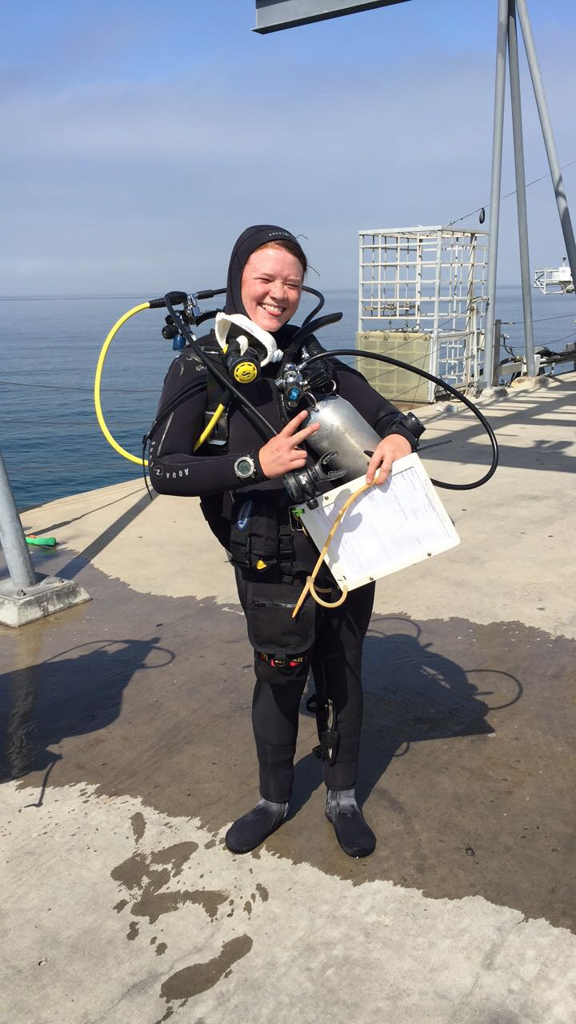

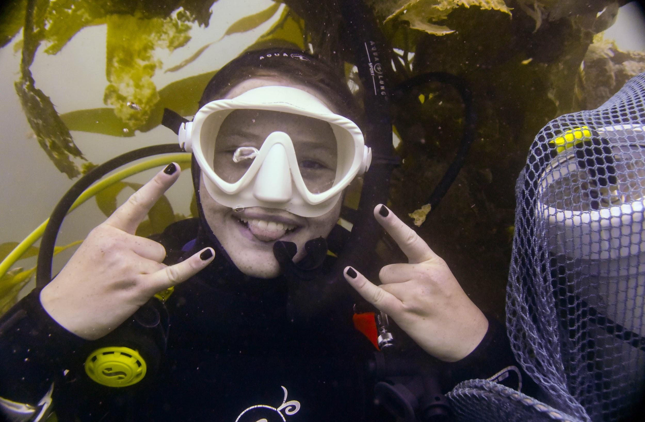
Add a Camera

Slide 27
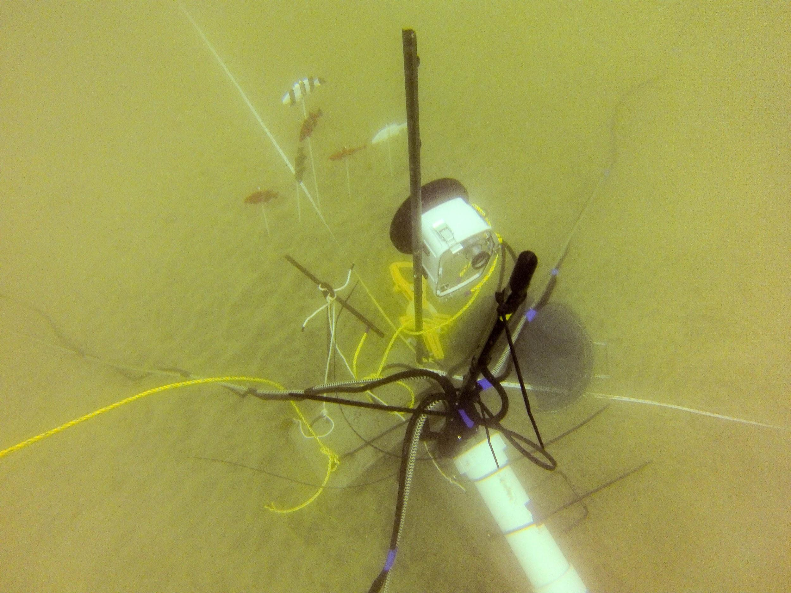
Add a Camera

Slide 28
Add a Camera
Hydrophone
Camera
Subsurface Buoy
Battery Pack

Slide 29
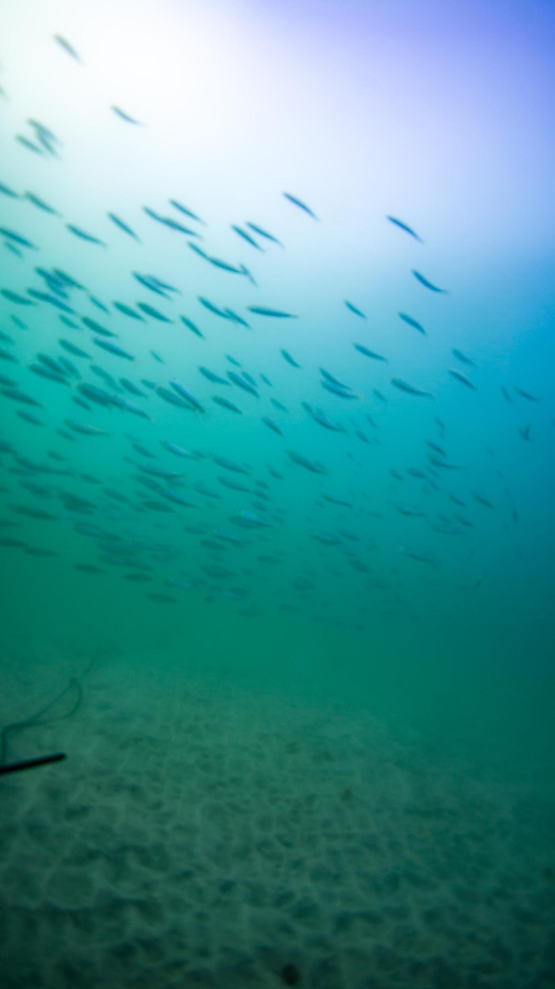
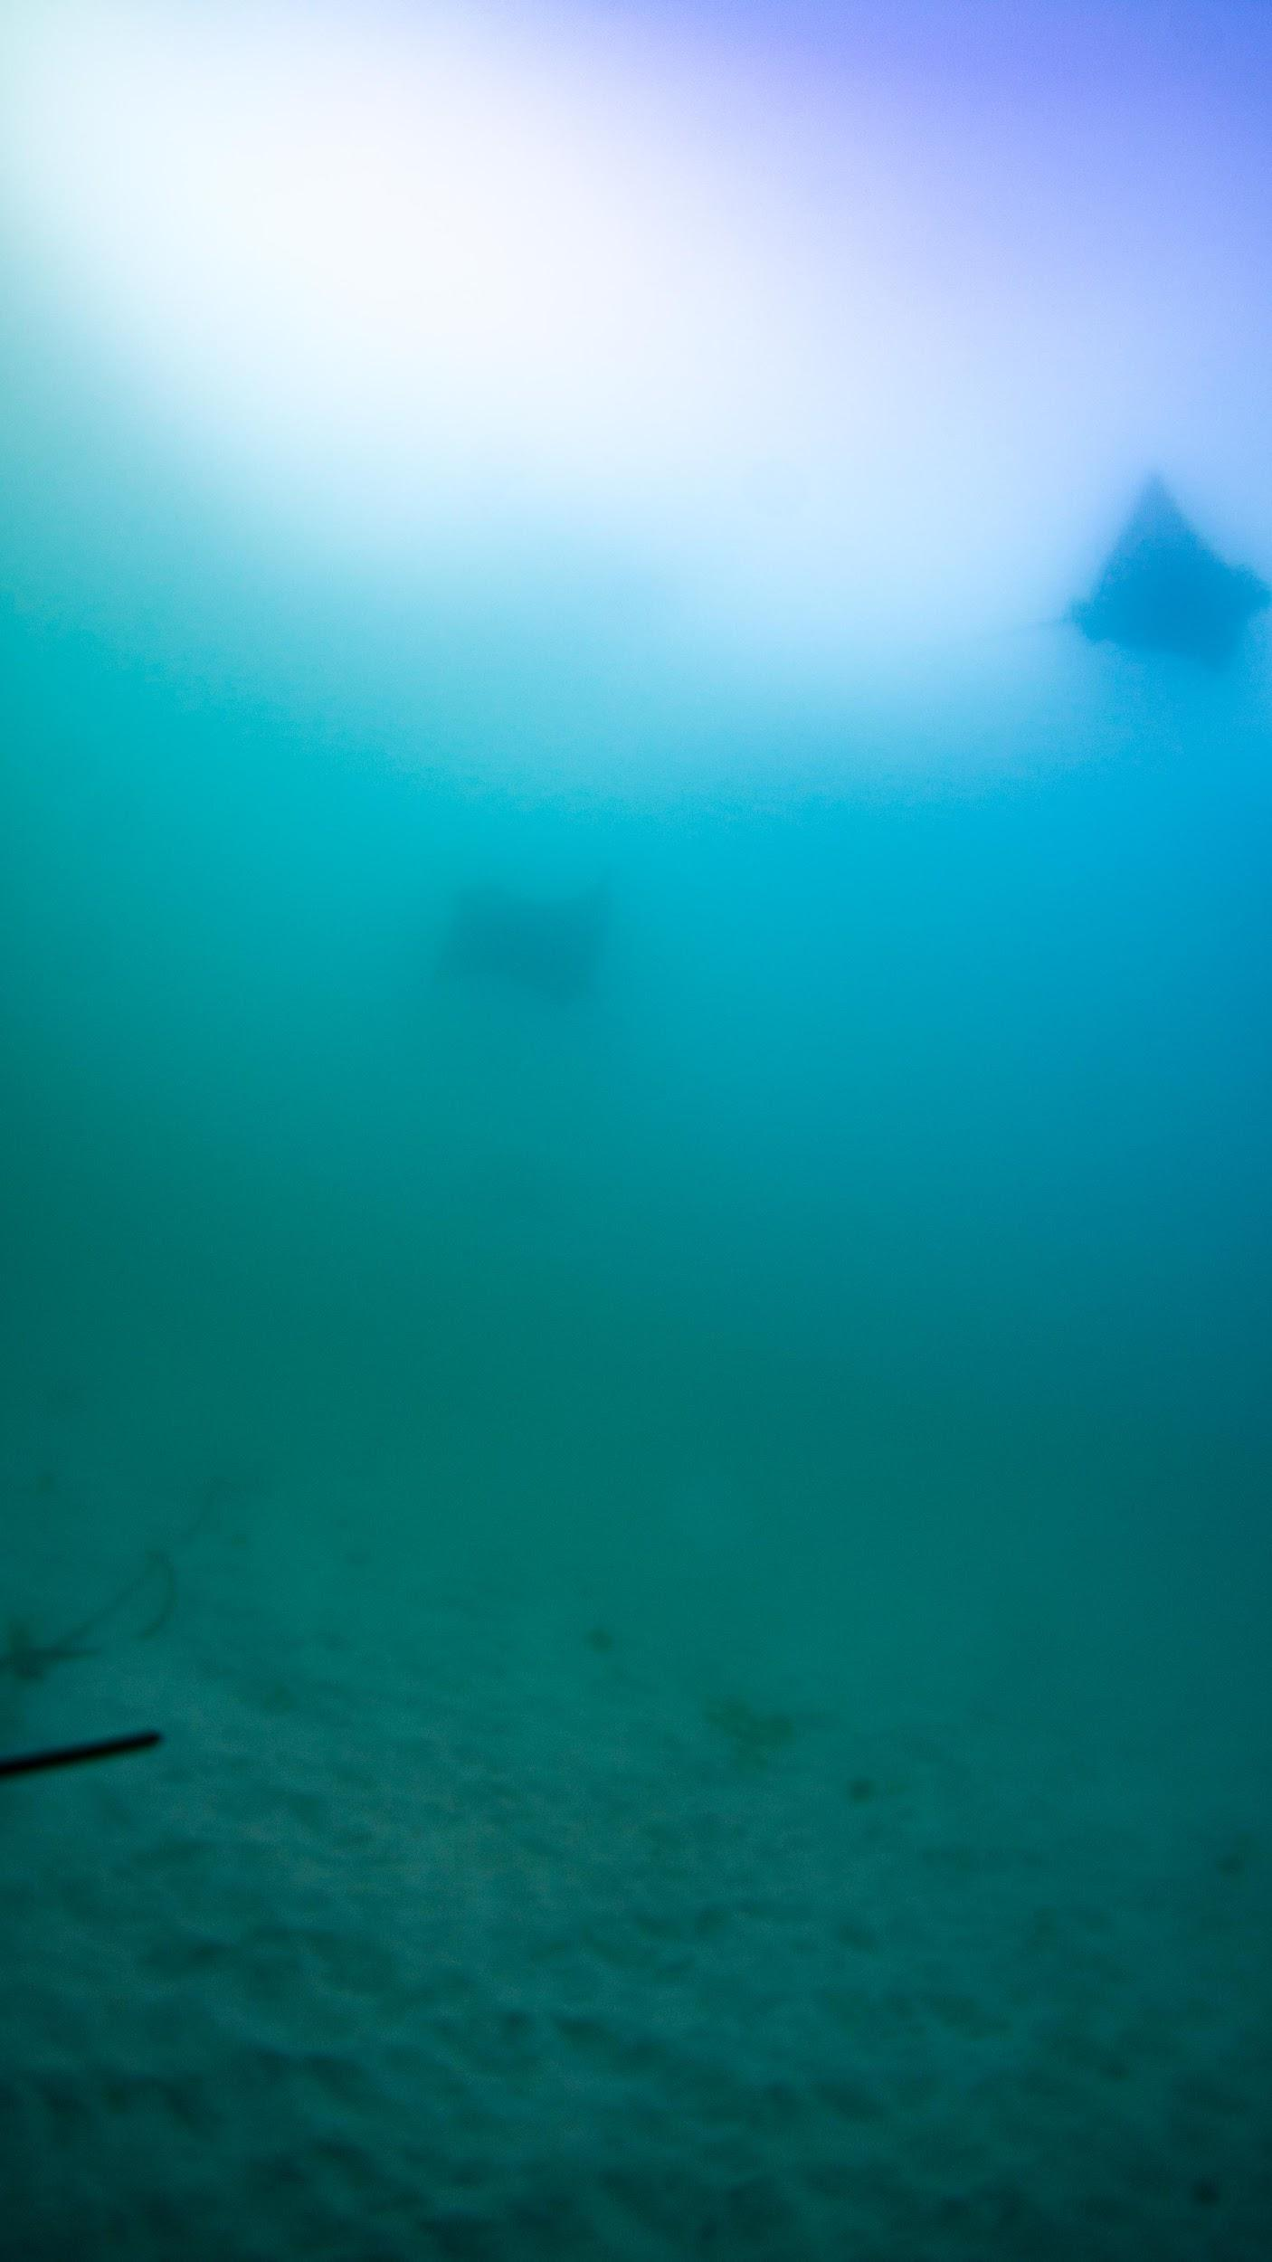
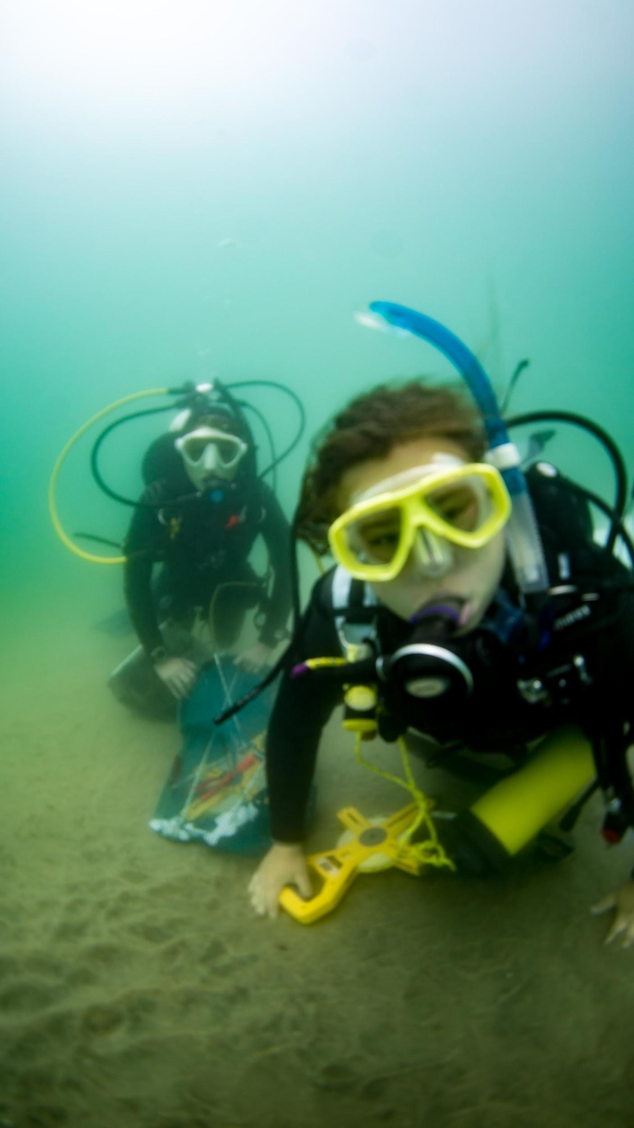
Add a Camera

Slide 30
FishOASIS

Slide 31
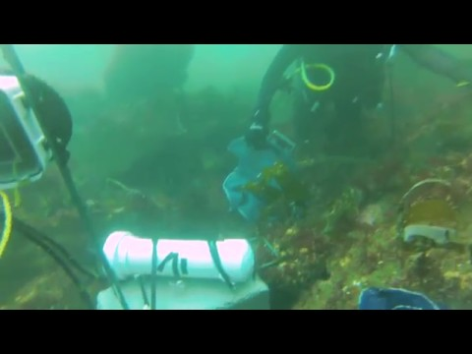
FishOASIS

Slide 32
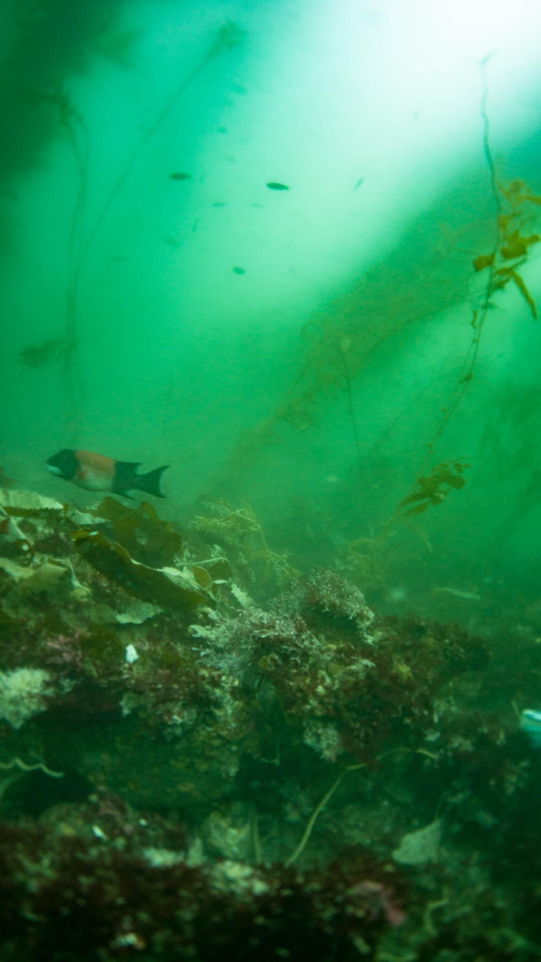
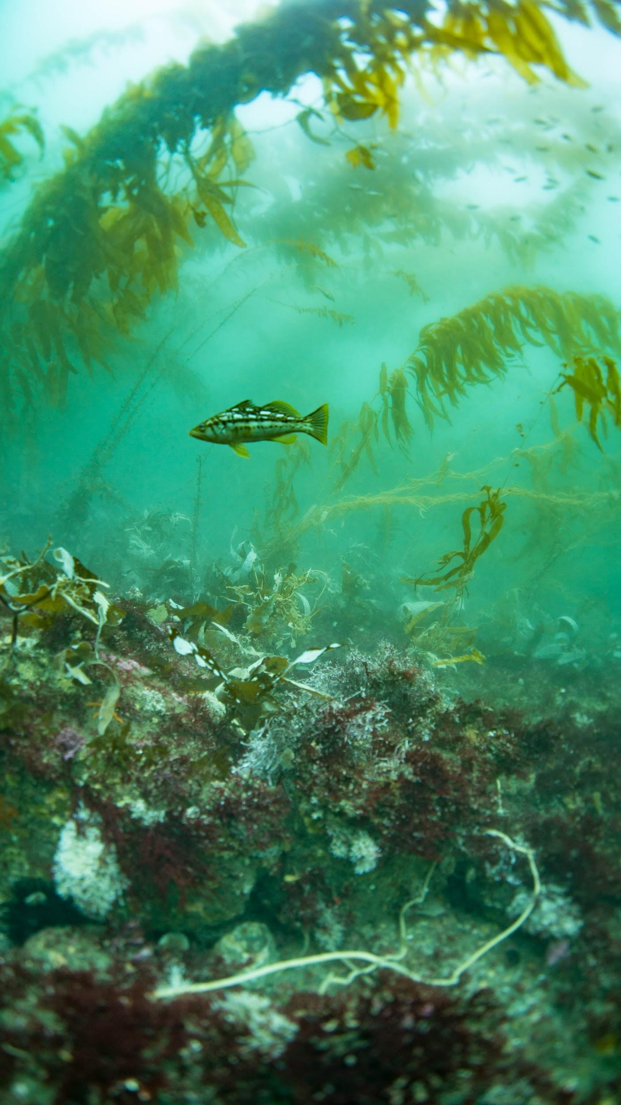
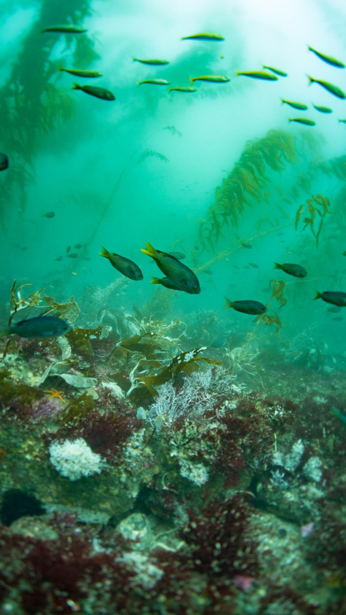
FishOASIS
Male Sheephead
Kelp Bass
Schooling Fish

Slide 33
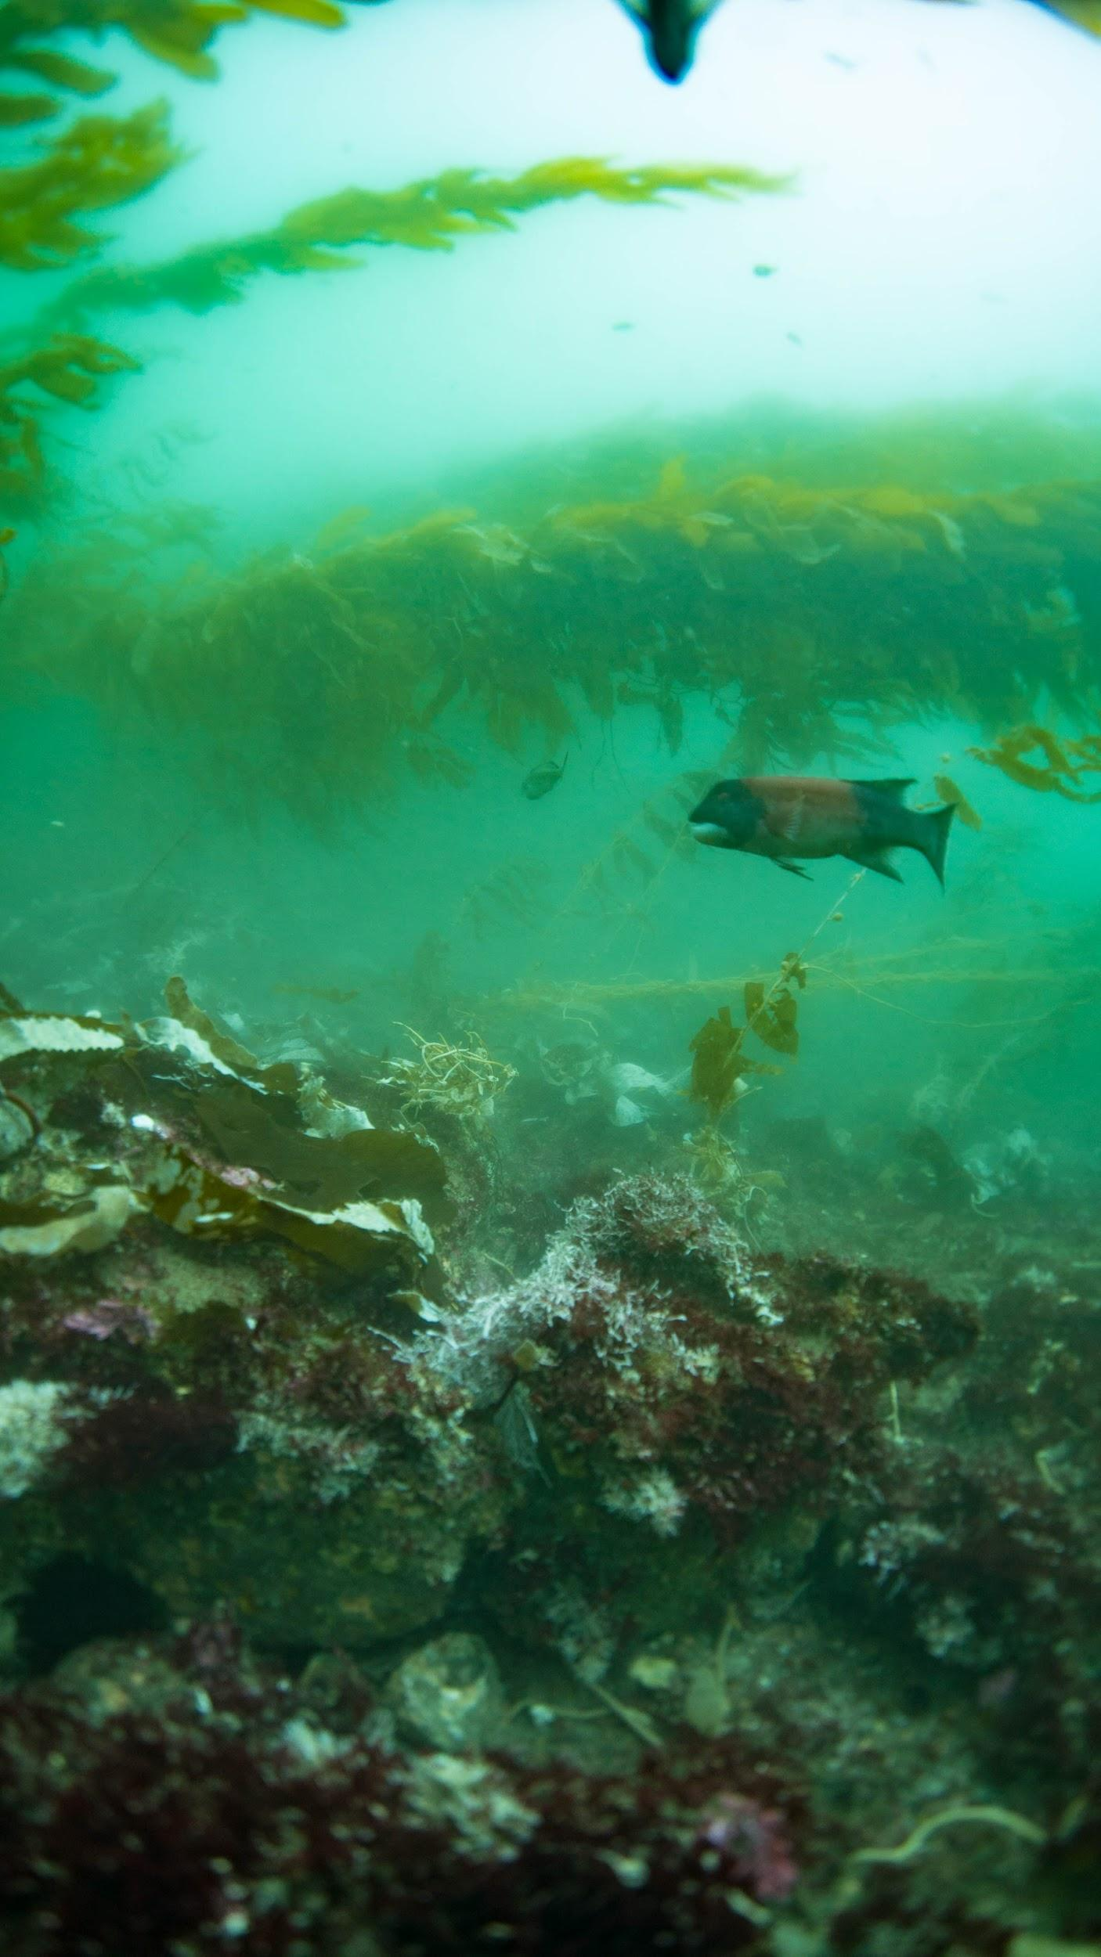
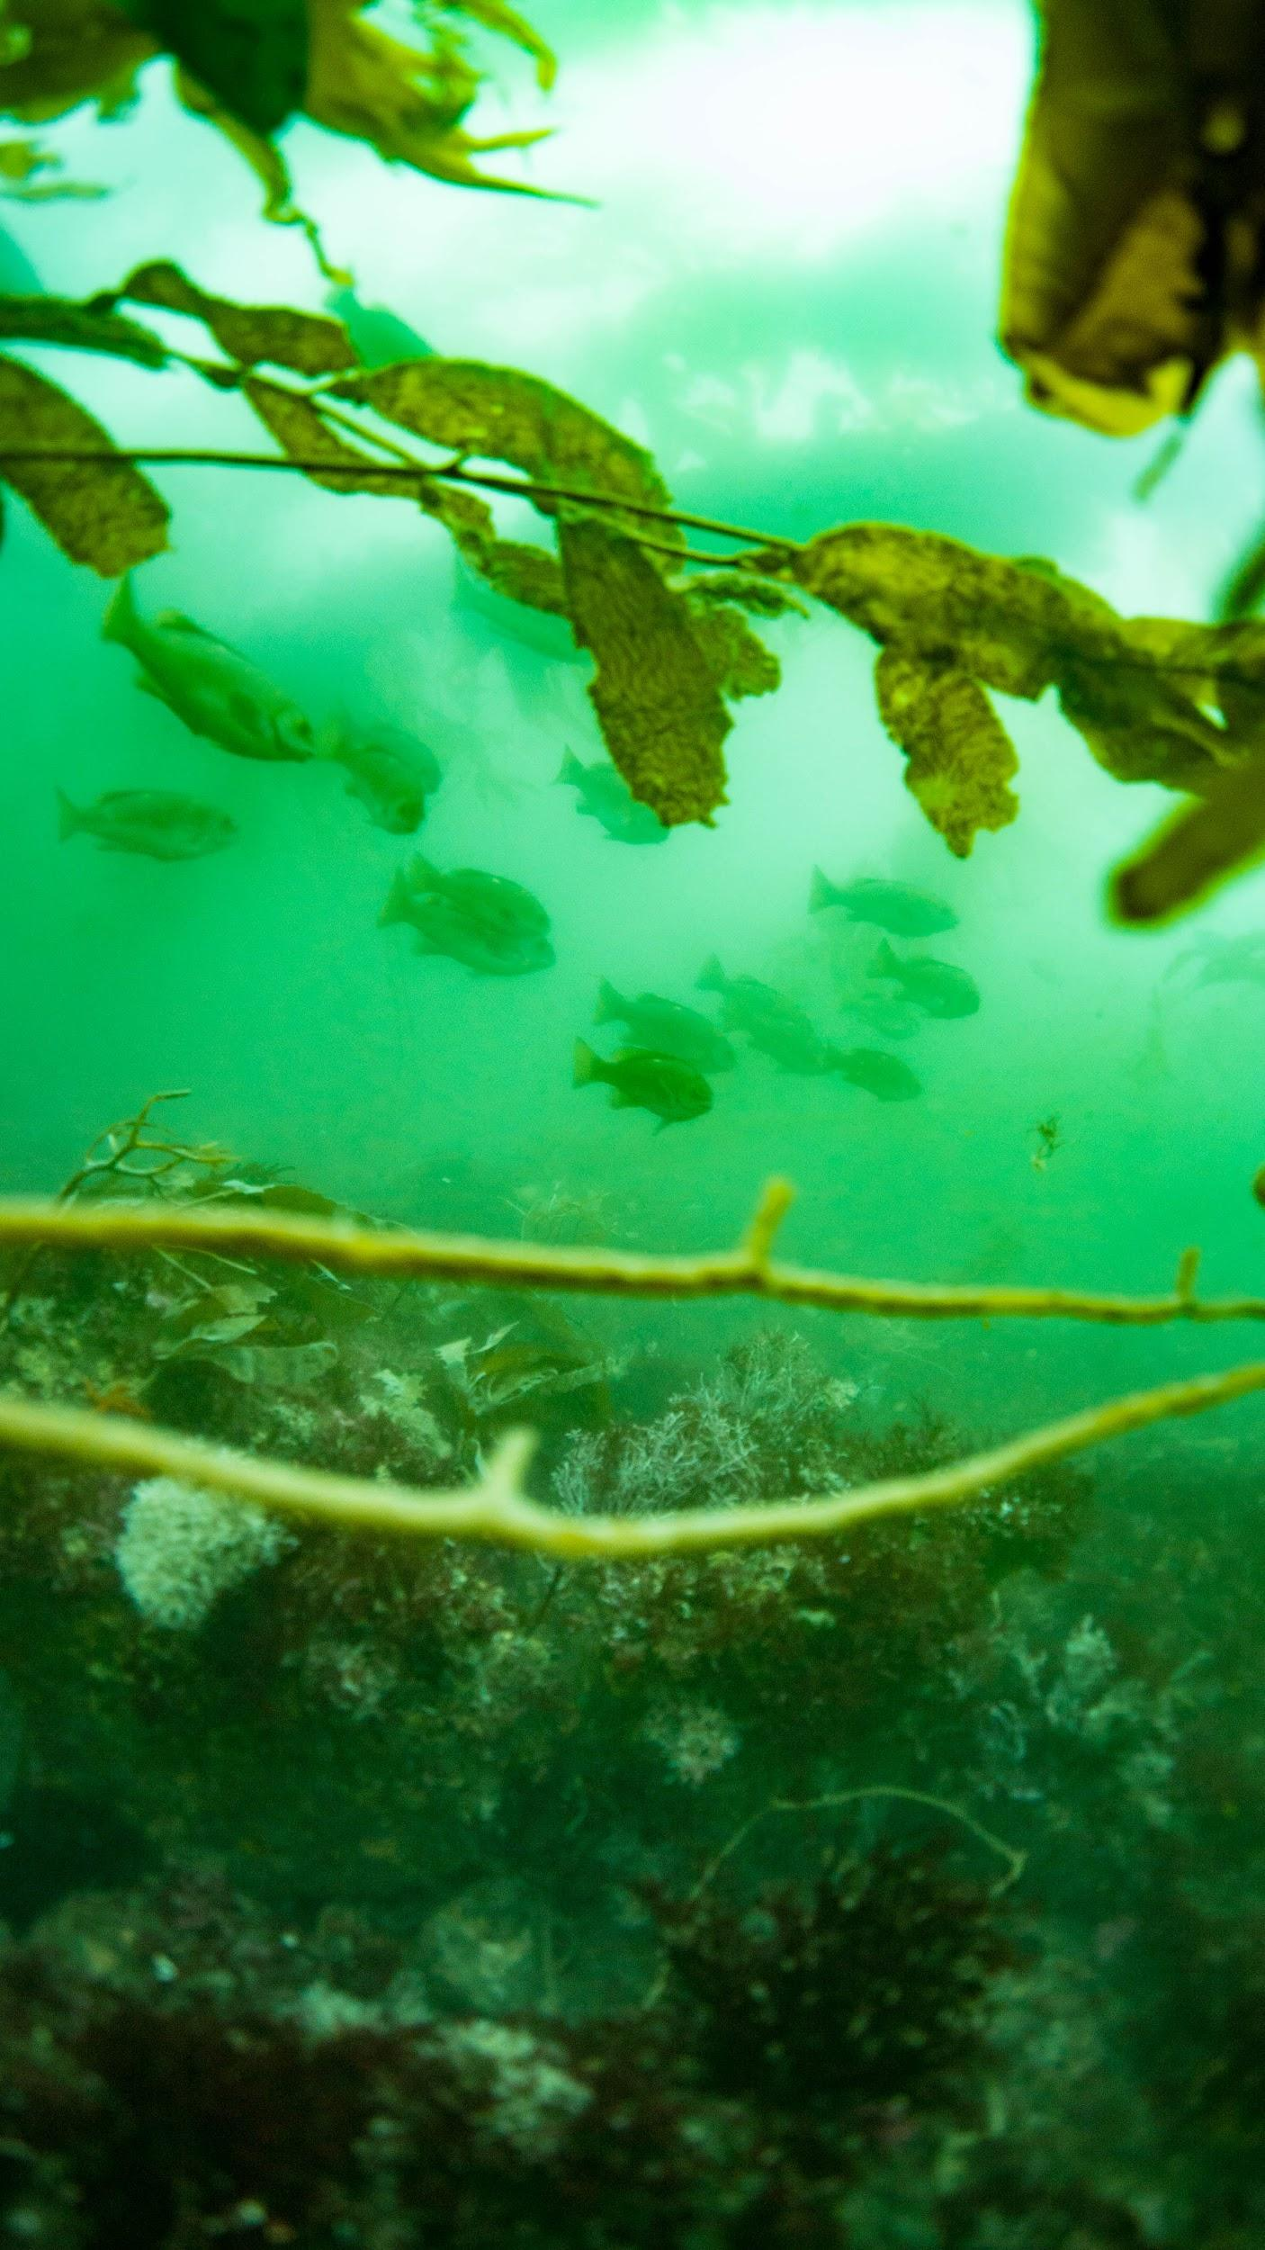
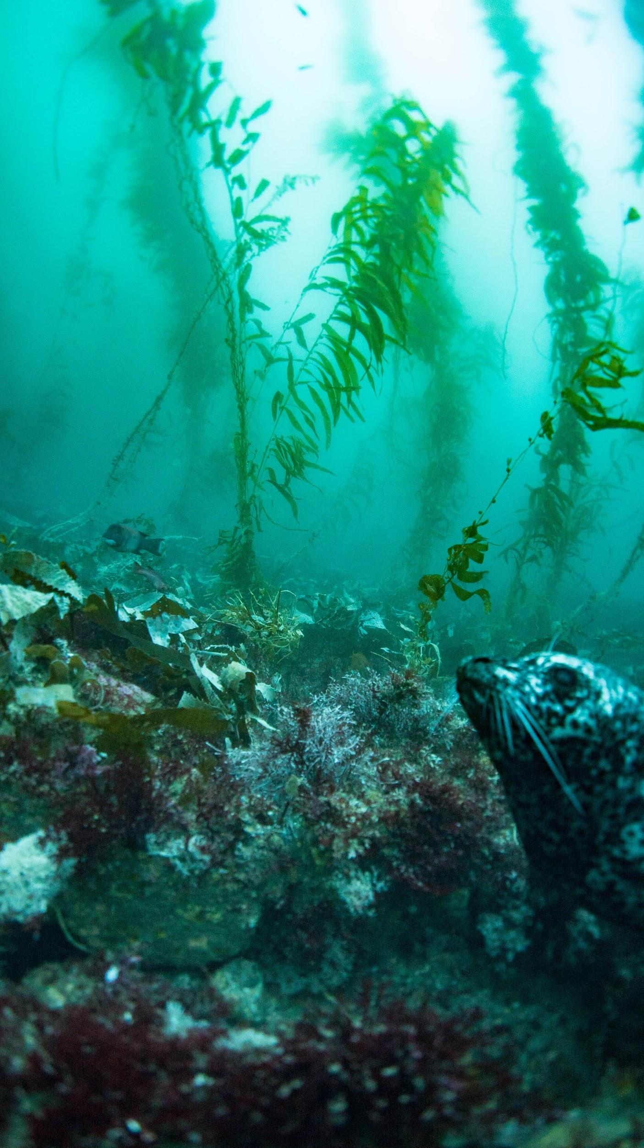
FishOASIS
Male Sheephead
Schooling Fish
Harbor Seal

Slide 34
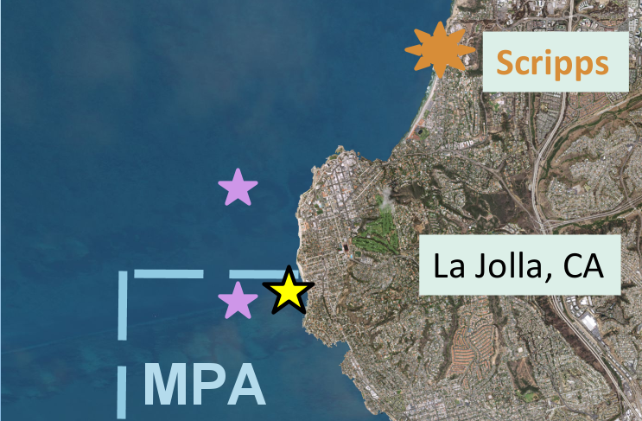
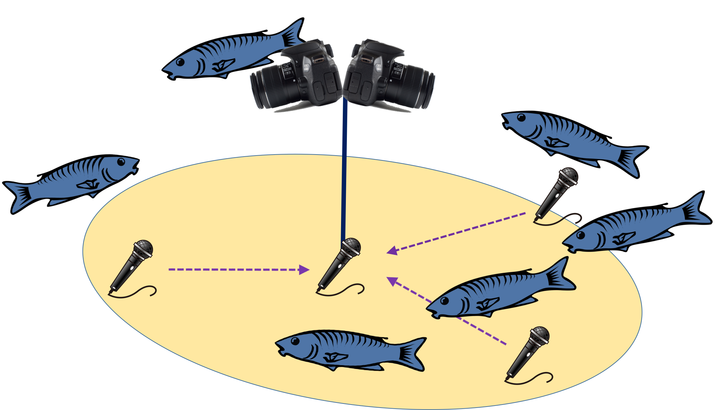
Future Work
Redeploy/Recover at FishOasis
Continue looking at other season’s log files
Use 360° camera system to identify the chorusing fish
Notes:
I was only able to cover the summer files, but there is also data for winter spring and fall. The next step would be to analyze those and see if there are seasonal trends within the annual trends, and if perhaps the chorusing starts earlier or later depending on the season.

Slide 35
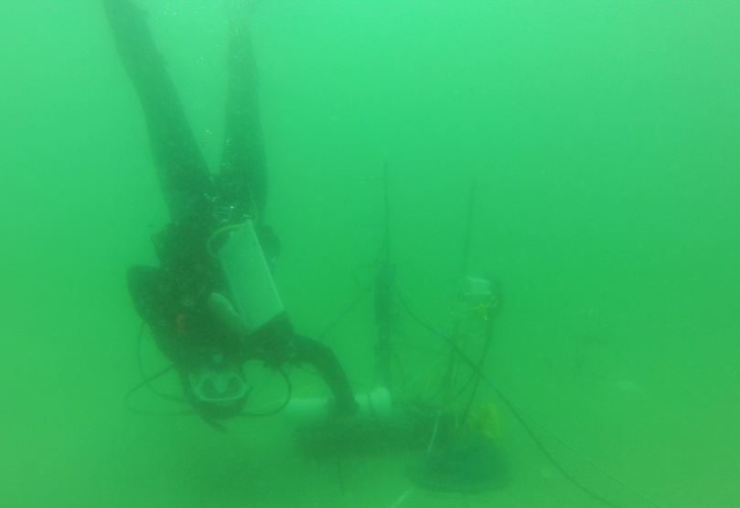
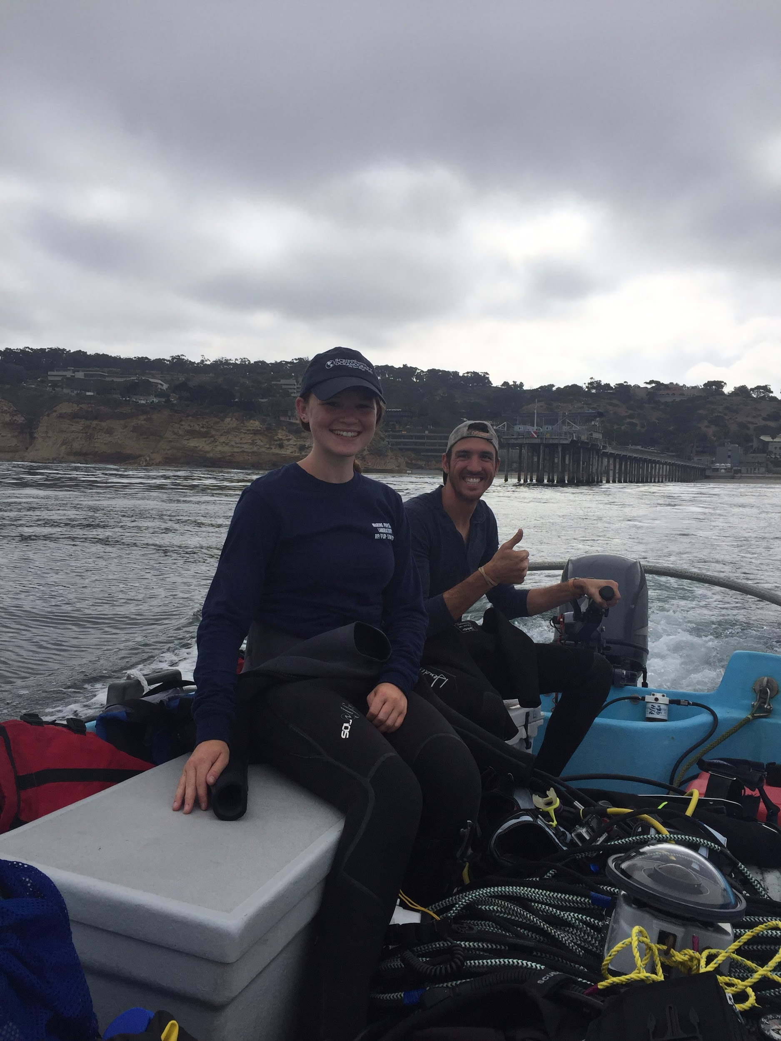
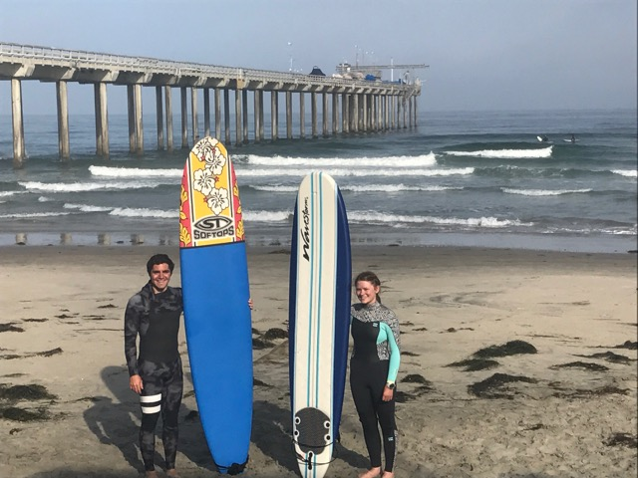
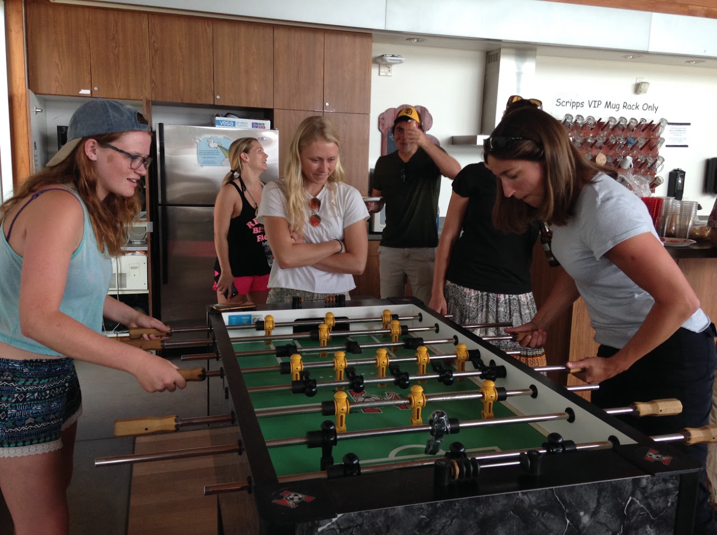
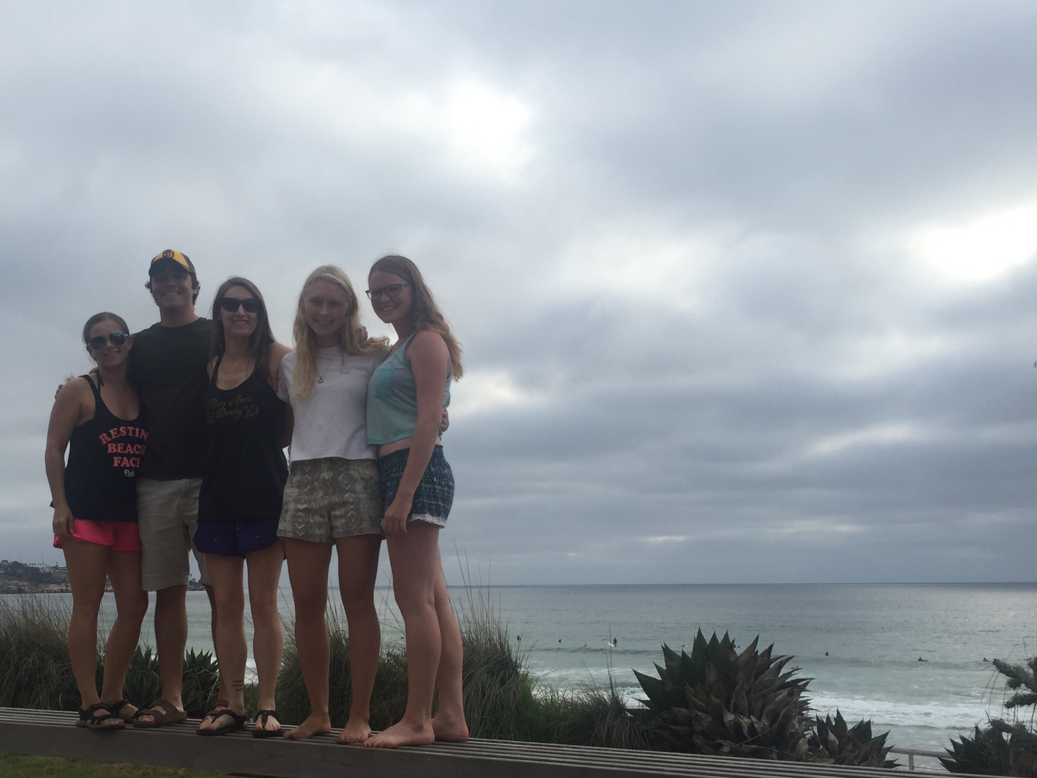
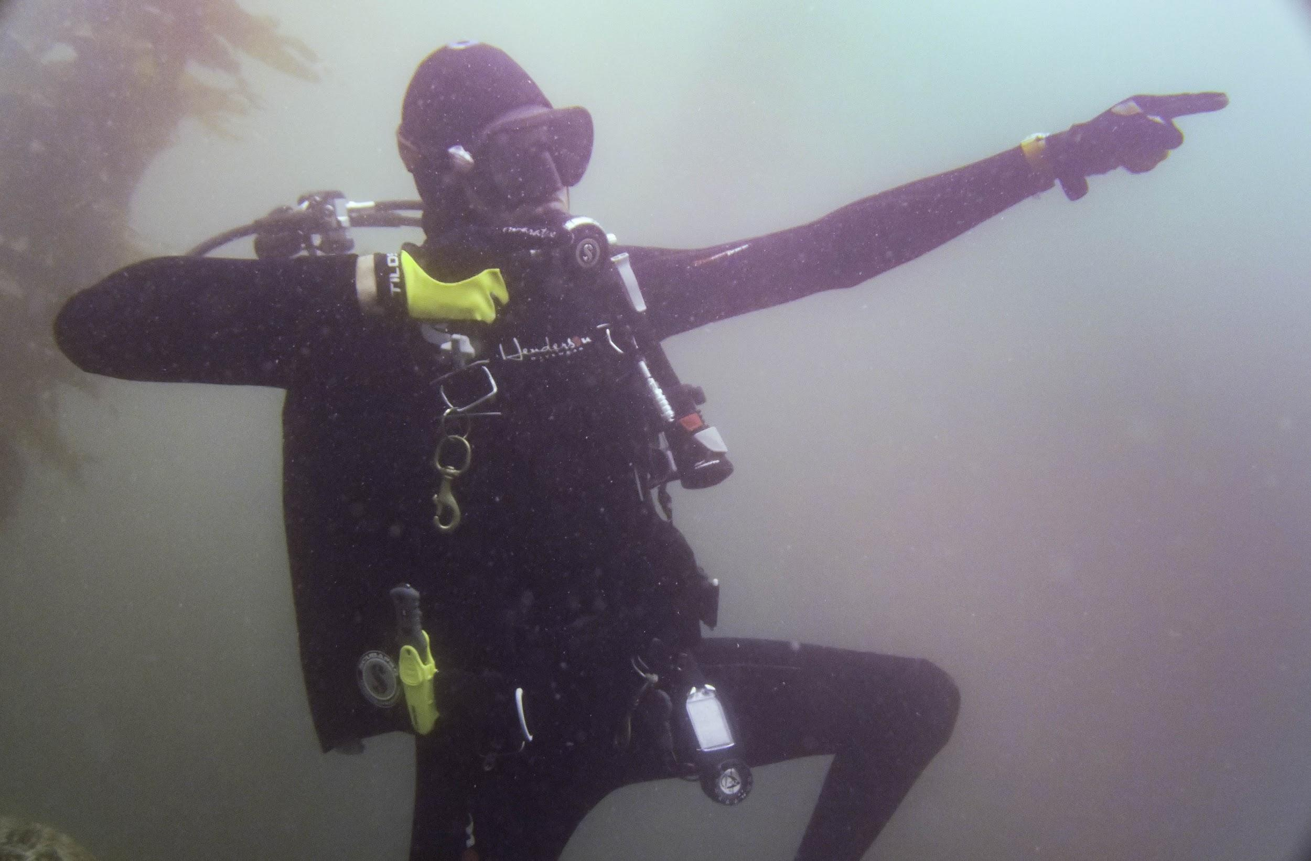
Acknowledgements
Marine Bioacoustics Lab
Jack Butler, Ana Širović, Camille Pagniello
Scientific Diving Program
Christian McDonald, Rich Walsh
MPL Intern Program
Eva Friedlander, Bev Kennedy, Sienna Thomas
All the other interns - I’ll miss you!

